Slide 1
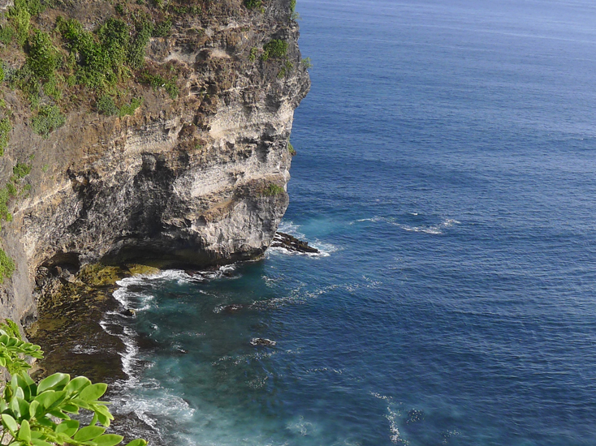
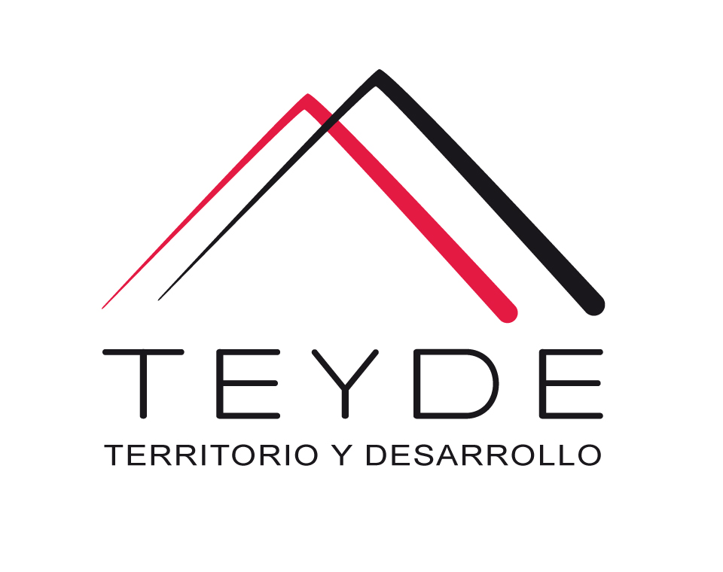



A tool for sharing ideas, knowledge and best practices related to climate change, green economies and sustainable development.

Slide 2
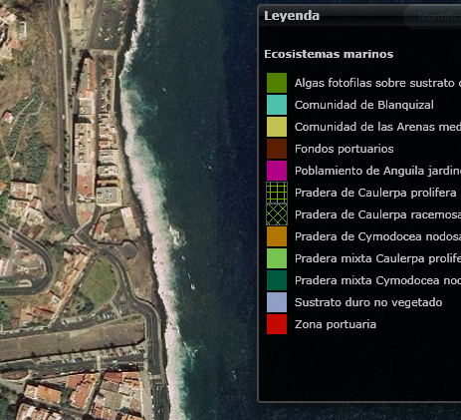
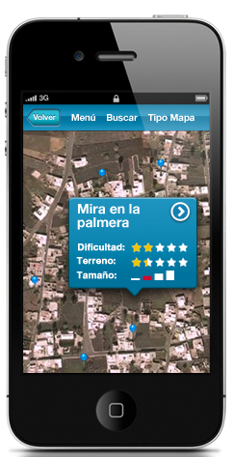
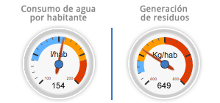
Introduction
Sustainability, the great challenge of the 21st century
Deforestation, water pollution, loss of key ecosystems such as moors... are generic environmental problems for the entire planet. Biosphere Reserves and other protected natural areas are privileged areas for sustainable development, learning spaces where policy makers, scientific communities, management professionals and local people work together to turn global principles of sustainable development into appropriate local practices, Subsequently can be applied globally.
TEYDE makes available to the Natural Spaces a complete set of tools oriented to the promotion and integral management of them: welcome to BiosphereSmart and RBDigital.

Slide 3
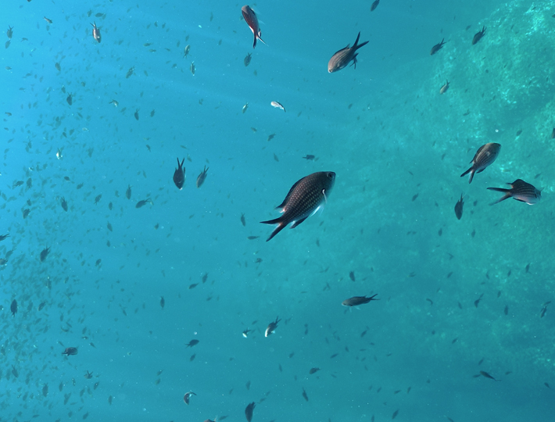
Biosphere Smart Collaboration as a motor for sustainable development

Slide 4
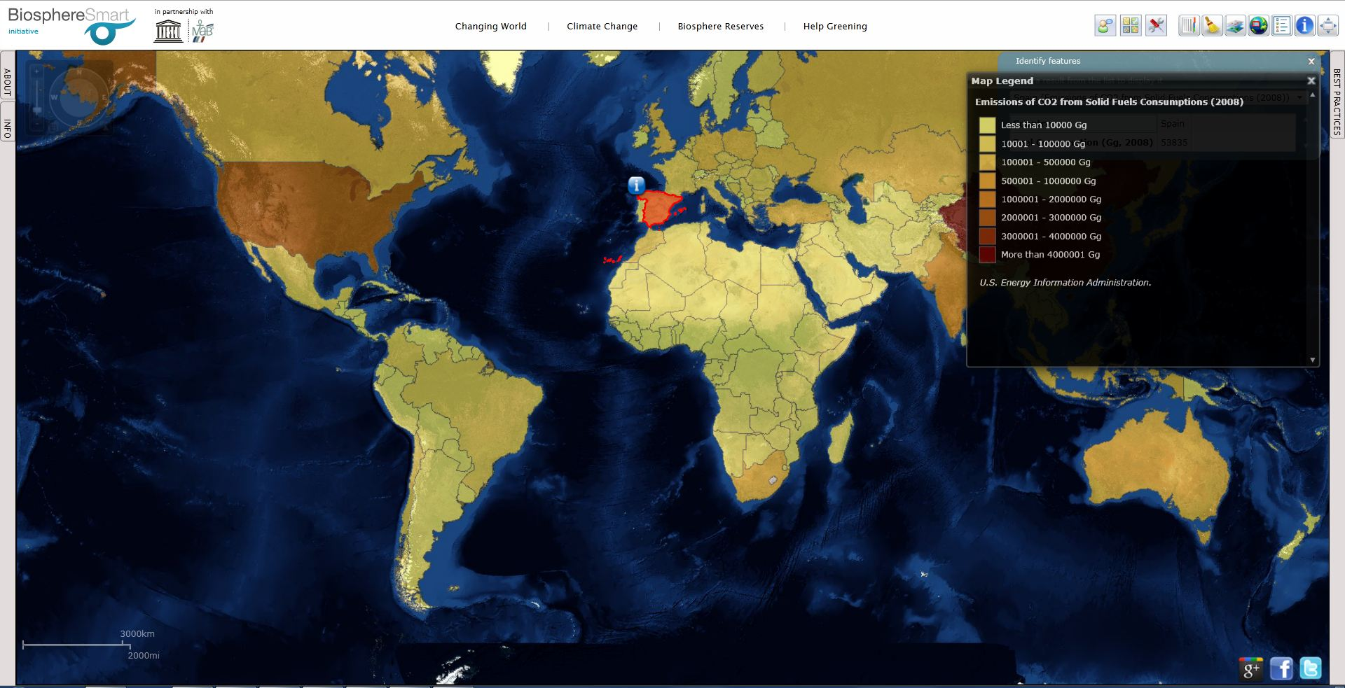
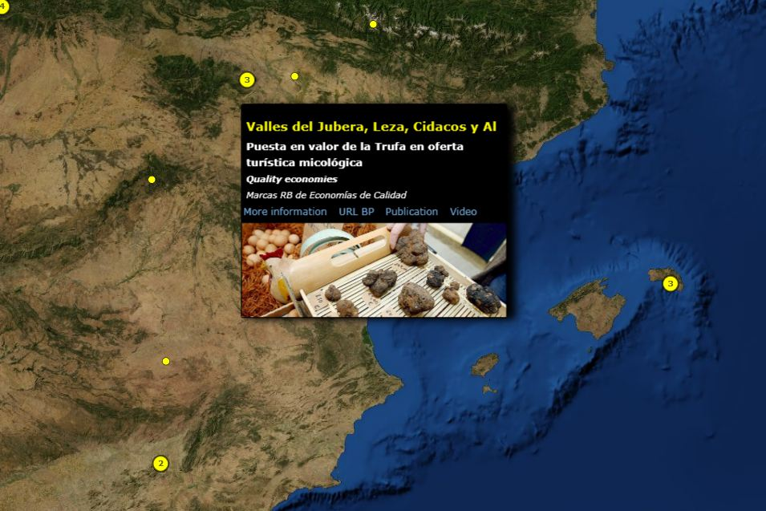

Biosphere SMART
Think globally, act locally
BiosphereSmart is an initiative aimed at promoting the global network of Biosphere Reserves, through a digital platform endowed with global tools of services and collaborative resources. The initiative was approved by the International Coordination Council (ICC_MaB) of UNESCO's MaB program in June 2012.
BiosphereSmart combines information and management functionalities to provide these spaces with conservation functions, research with a 2.0 orientation that enables the dissemination of good practices and the collaboration of citizens.

Slide 5
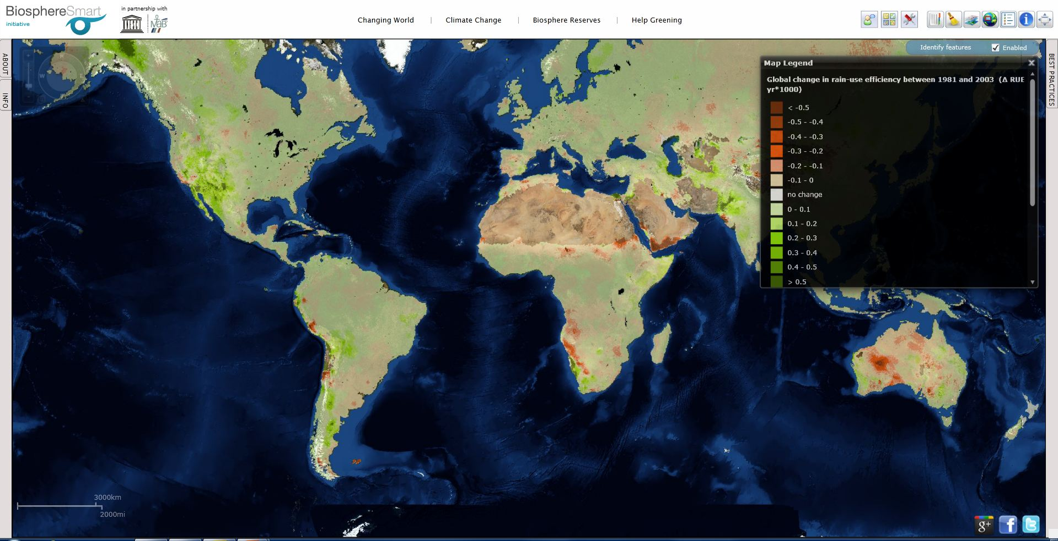
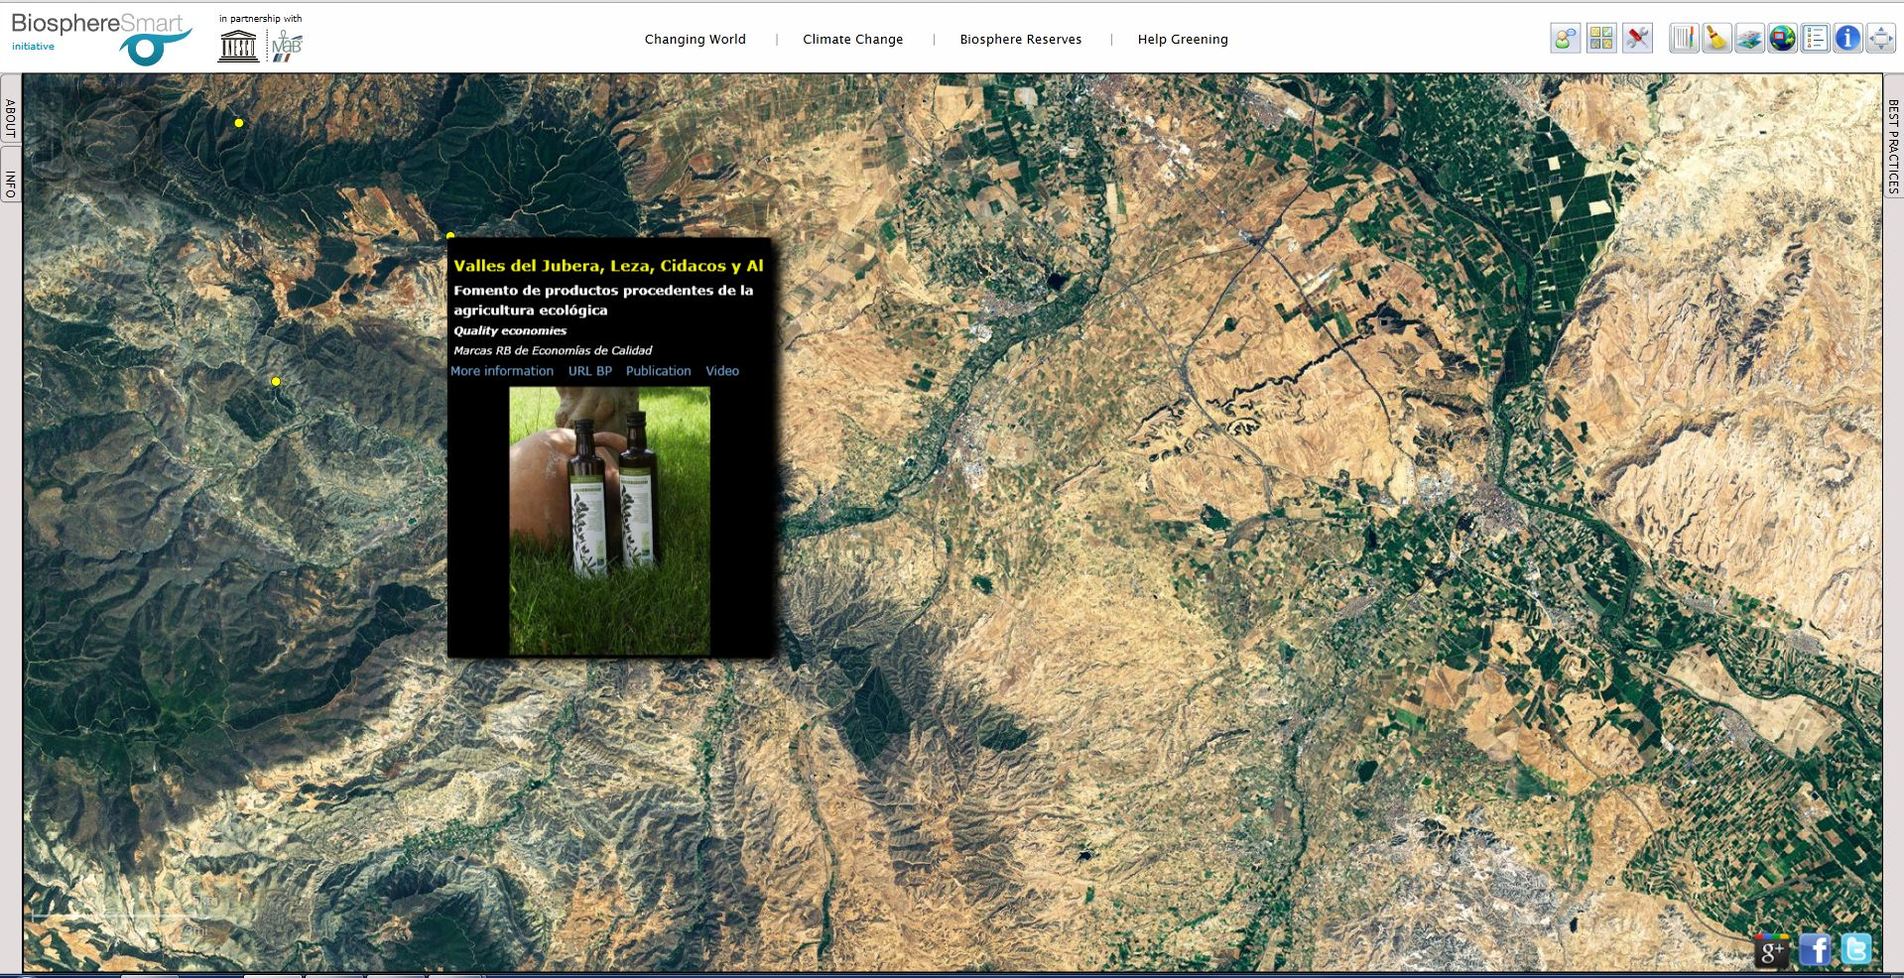
Biosphere SMART
Features
1. Accessible information.
BiosphereSmart contains georeferenced information of the RBs (water cycle, waste management ...) Access to the web portal of each RBs, to documents in PDF format ... provides a complete information to the visitor.
2. Collaborative knowledge.
BiosphereSmart contains a BB.DD. With "best practices" in managing RBs, green economies and sustainability. The functionalities allow an easy grouping by categories (fauna, flora ...). The 2.0 character allows citizens to contribute their "best practices" will be incorporated into the platform.

Slide 6
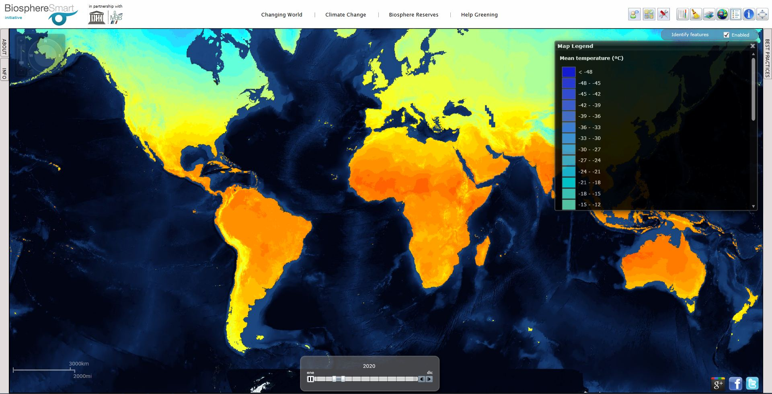
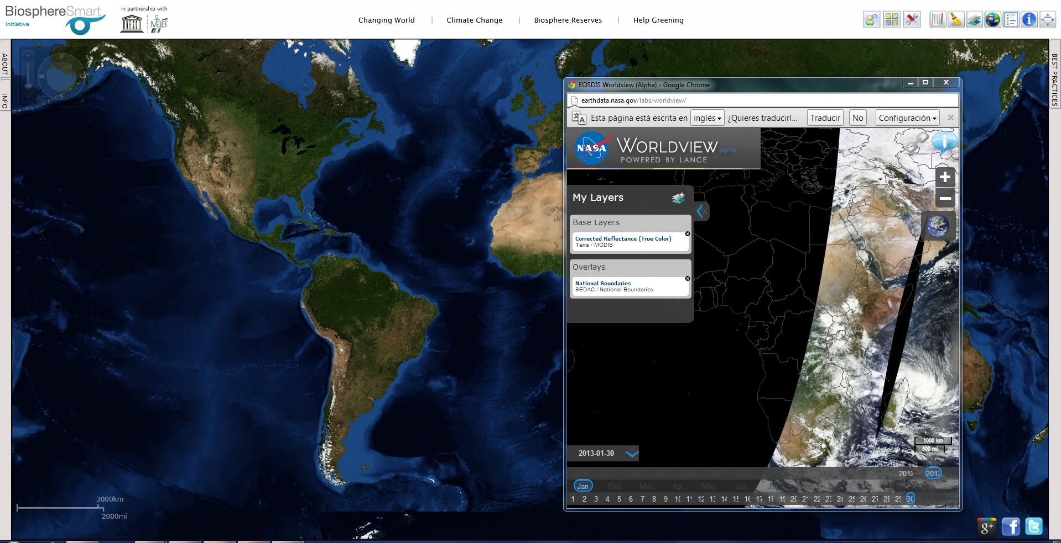
Biosphere SMART
Features
3. Data for decision making.
The temporal and sequential maps allow simulating future scenarios in terms of climate change and urban planning, essential to develop palliative and corrective measures in the present.
4. Ready to grow and compatible.
Following the beta concept, BiosphereSmart is a tool in continuous evolution and adaptation to the requirements of its clients; On the other hand it is compatible with other geo-referenced data and remote sensing providers: WMS, ArcGIS Online and KML / KMZ.

Slide 7

RBDigital
The next
Biospheresmart STAGE

Slide 8
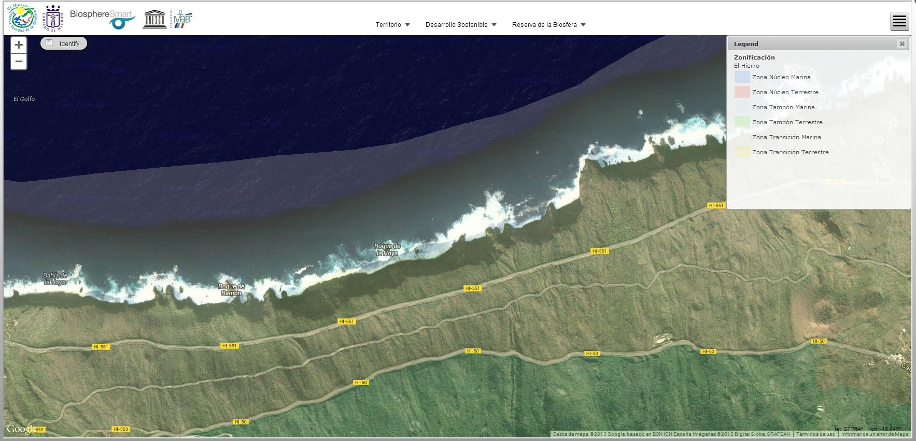
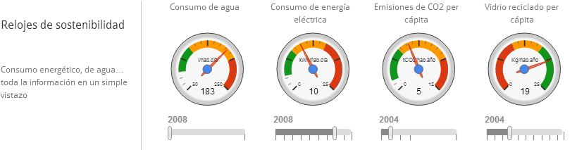
RB Digital
All the information in a single click
Social Networks, Smartphones ... we are currently receiving information from multiple sources and the most precious asset is being able to keep informed in the shortest time possible.
RBDigital is articulated under this idea: a suite of solutions that allow easy and quick access to all the necessary information for the integral management of a Biosphere Reserve in its functions of conservation, development and logistical support.
RBDigital is customized according to the needs and particular characteristics of each reservation: high mountains, islands, arid zones ...
RBDigital can easily adapt to the management
of other Natural Spaces such as RAMSAR sites, Sanctuaries
of fauna and flora, Natural Natural Areas, etc.

Slide 9
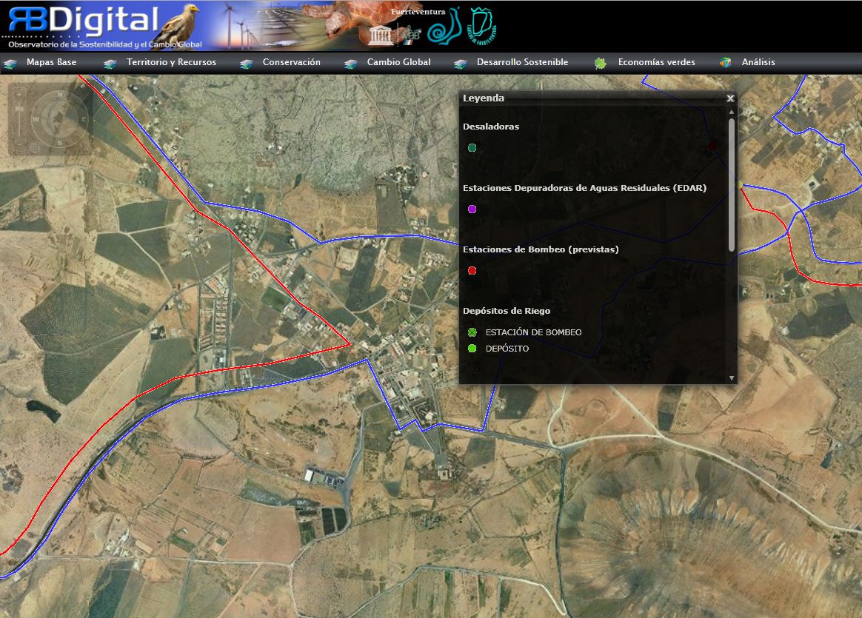
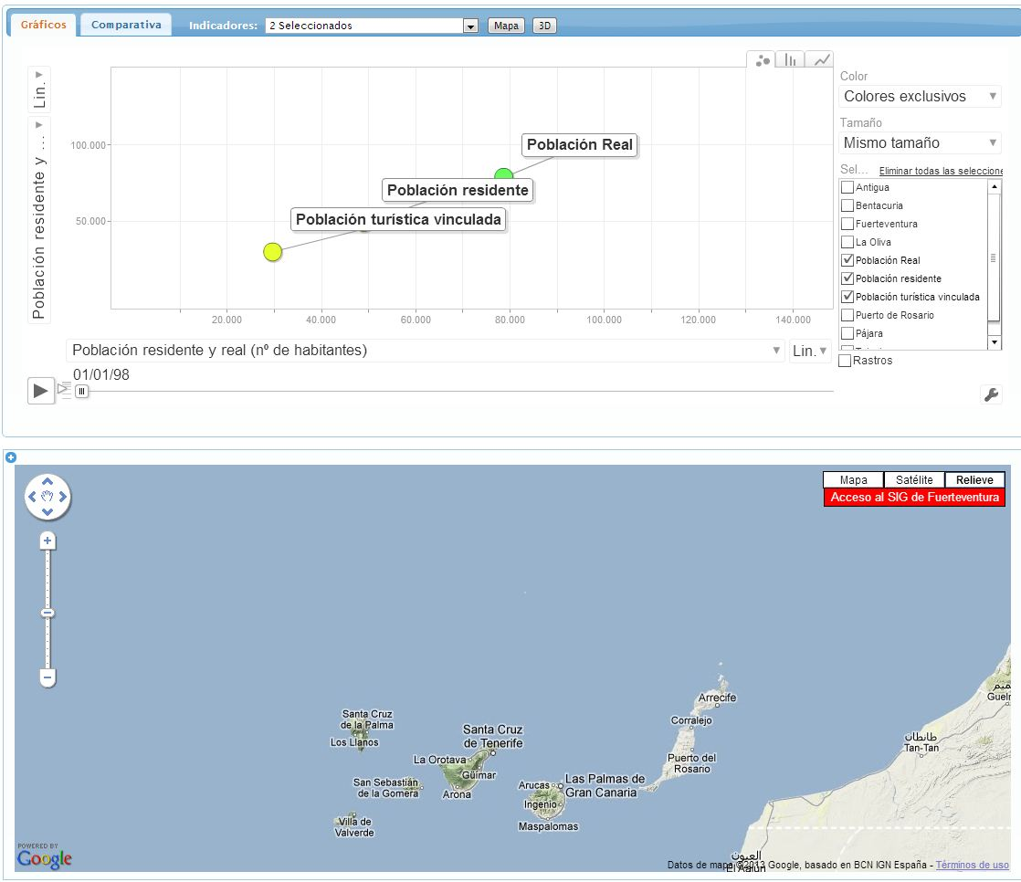
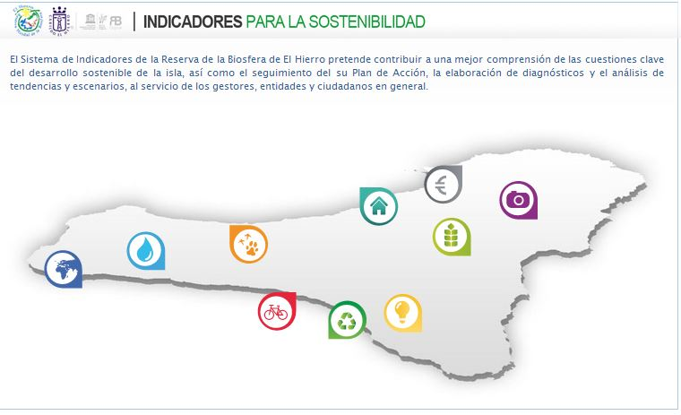
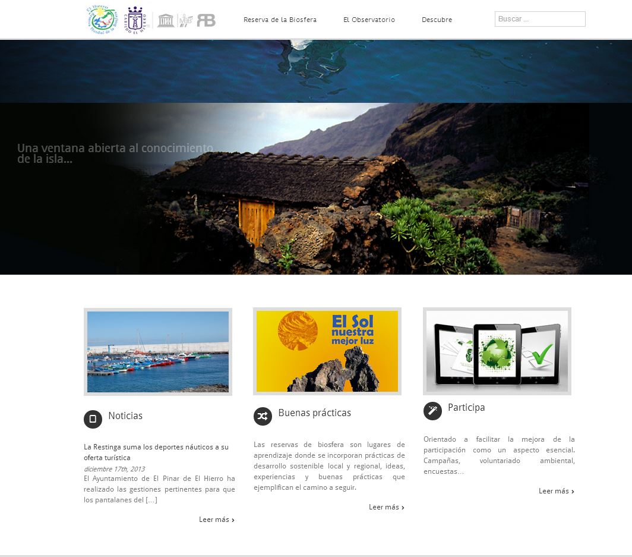
RB Digital
Suite soutions
RBDigital is composed of a suite of solutions that follow the following orientation :
Management
GIS viewer
Indicators viewer
RB observatory
Disp
Information Participation
Smart Portal
Sutainability watches
Apps Green

Slide 10
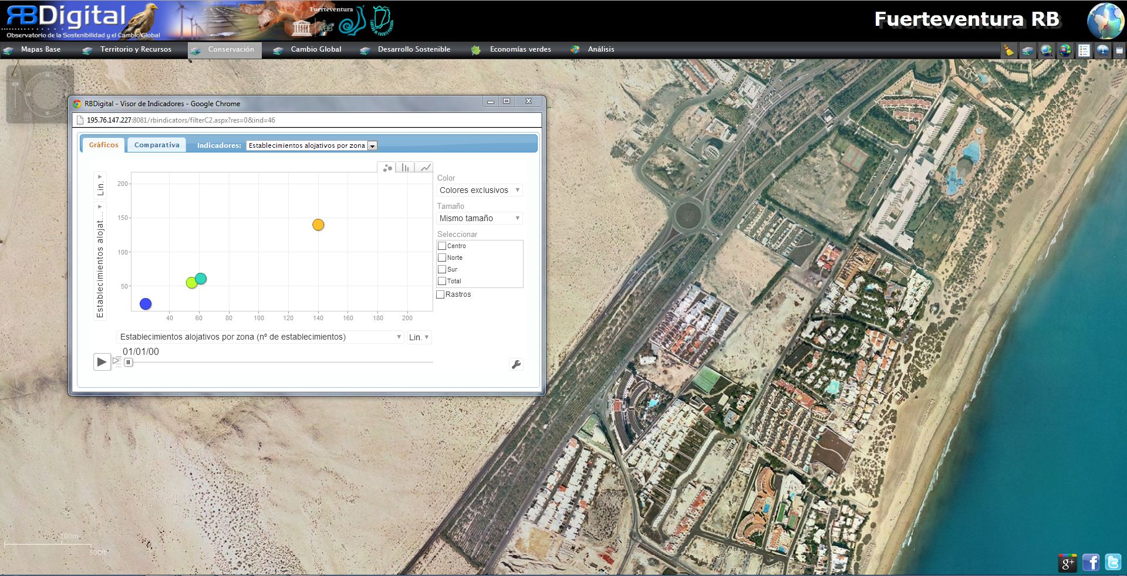
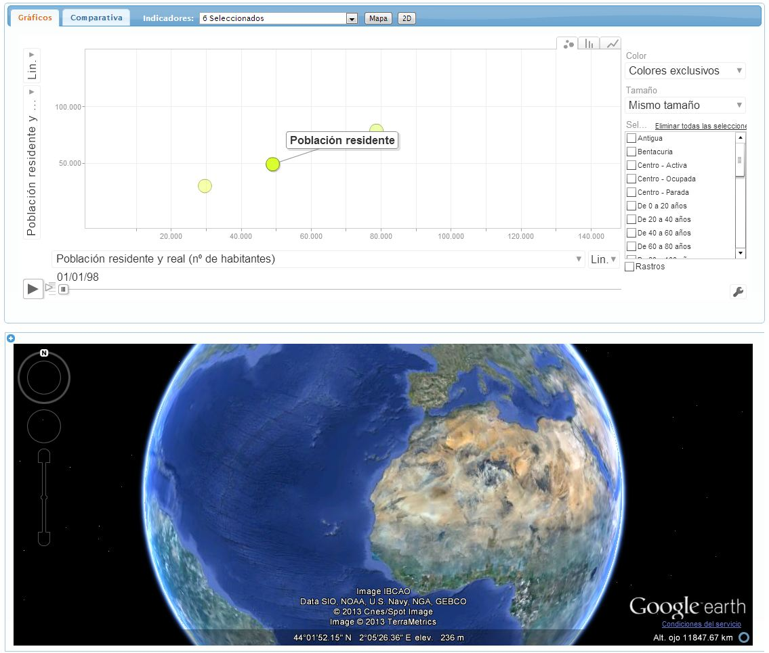
RB Digital
Viewers: the information in full detail.
RBD viewers provide access to detailed, friendly, intelligent information ... which facilitates decision-making in the management of the Biosphere Reserve.
GIS viewer
Module GIS tool with thematic layers of territorial and general sustainability (zoning of the reserve, vegetation, geology, topography ...), and also related to the Strategic Plan and Plan of Action of the Reserve.
2. Indicators viewer.
Customized visualizer based on the sustainability indicators defined by the Biosphere Reserve. This visualizer will allow the identification, analysis ... of these indicators, so as to facilitate access to information and especially decision making for the management of the Reserve
10

Slide 11
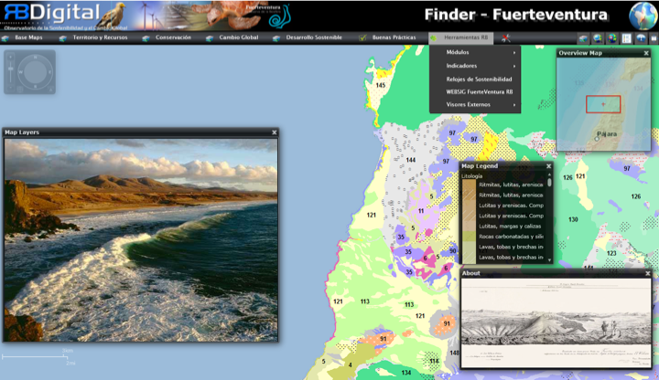
RB Digital
Observatory and Apps: the value of information
RBDigital's "suite" orientation allows the interoperability of data between its solutions so that, once processed, it becomes useful information for decision making, its use for specific applications ...
Observatory
Process the information contained in digital RBD to facilitate decision making in matters of sustainable tourism plans, management of littoral and waters …
APPS
Possibility to create a wide range of themed apps for the promotion, management ... of the reserve: geocaching, sky guides.

Slide 12
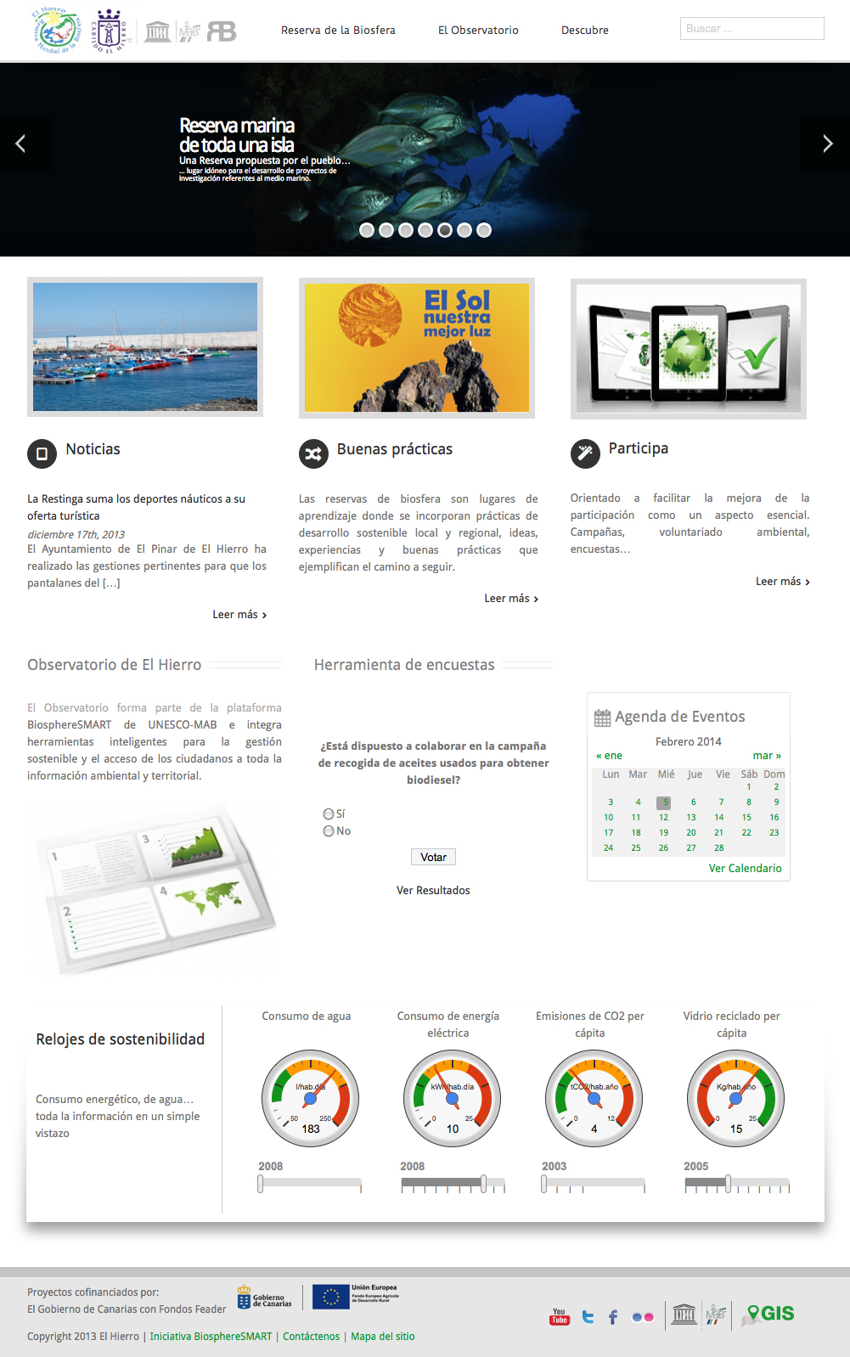
RB Digital
Smart Portal
“Dashobard” concept
All the information available at a glance.
Simple structure for easy access to the most outstanding suite options.
12

Slide 13
RB Digital
Smart Portal
"Dashboad" concepto
Toda la infomación disponible de un simple vistazo.
Estructura sencilla para facilitar el acceso a las opciones más destacadas de la suite.
13

Slide 14
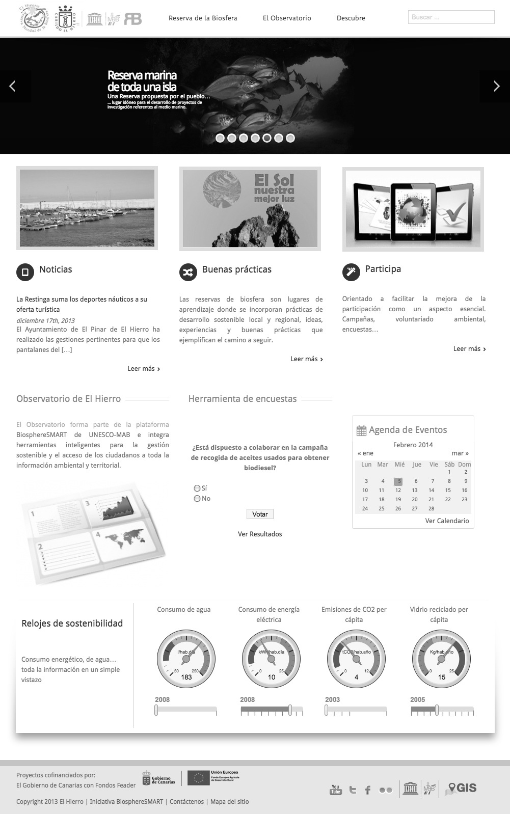
RB Digital
Smart Portal
Customizable.
To the visual identity (logos, corporate colors ...)
Of the Reserve
Flexible structure.
The portal can be simply adapted to the needs of any protected natural space
14

Slide 15

RB Digital
Smart Portal
Intuitive.
Centralized access to the different functionalities of RBD Digital
15

Slide 16
RB Digital
Smart Portal
Participatory.
Surveys,
forums ... allow citizens to participate in Reserve.
16

Slide 17
RB Digital
Smart Portal
z
Structured information
According to the functions of conservation, disclosure ...
17

Slide 18
RB Digital
Smart Portal
Social
Integrated with the most popular social networks.
z
18

Slide 19
RB Digital
Smart Portal
Dynamic
Automatic update of news, coments…
z
www.teyde.pe l 2014
19

Slide 20



RB Digital
Smart Portal
Multi platform
The portal is also visible on mobile platforms
z
20

Slide 21
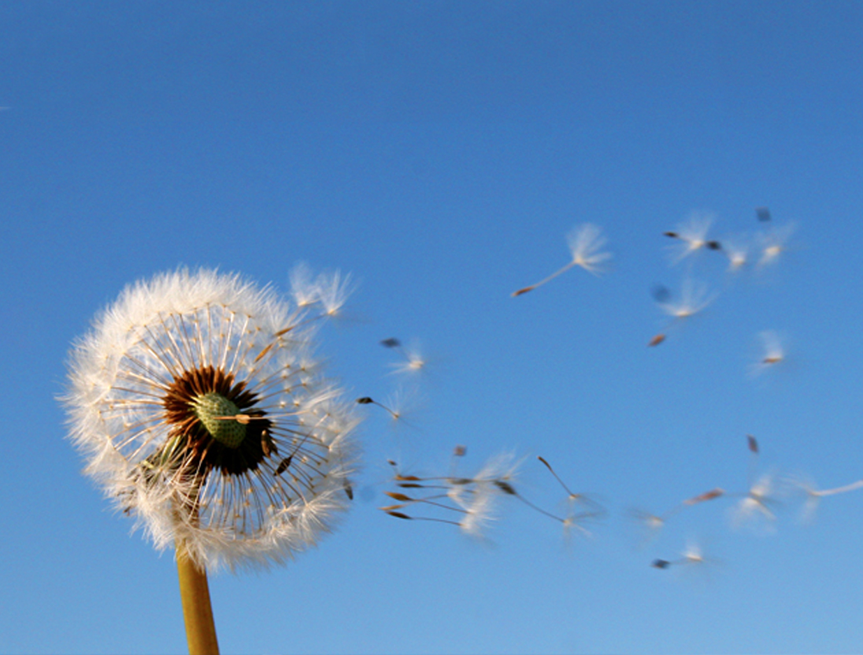
We are in:
+ España
Fernández Navarro 50, 3ºA.
37003. Santa Cruz de Tenerife.
España
+ Colombia
CR 10 # 73 20 Oficina 202.
Bogotá. Colombia.
+ Perú
Urb.Las Fresas,Mz V , Lte 12.
Santiago de Surco, Lima 33.
Lima, Perú.
+ Cel: +34 619 745 190
+ Cel: +51 962 675 092
+ Cel. +51 948 893 145
+ ghduran@me.com
+ www.teyde.pe

