Slide 1
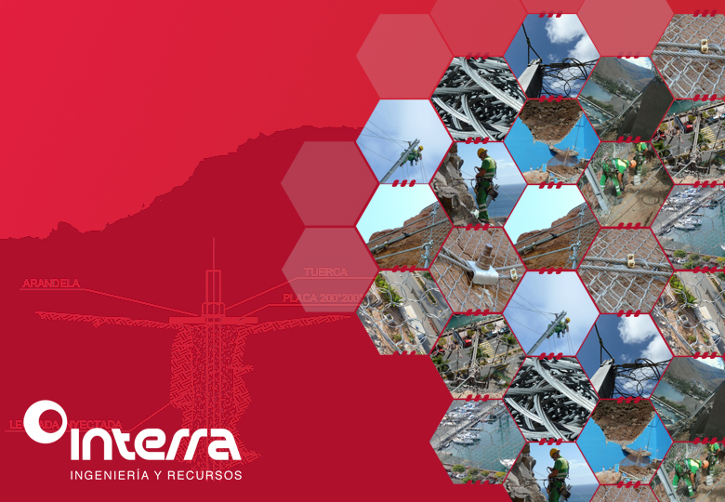
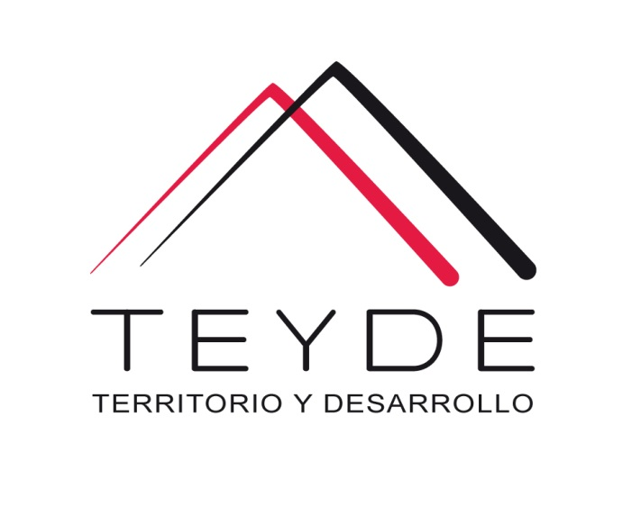
Services in
Geological hazards
OFFSHORE

Slide 2
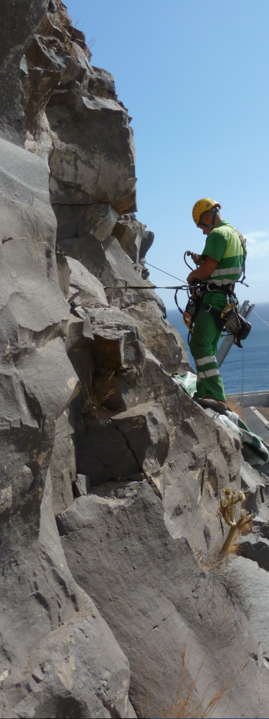
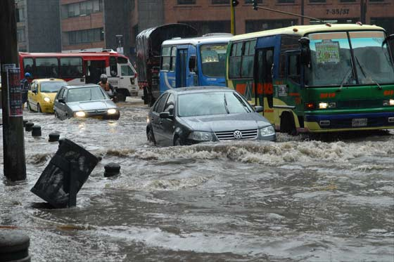
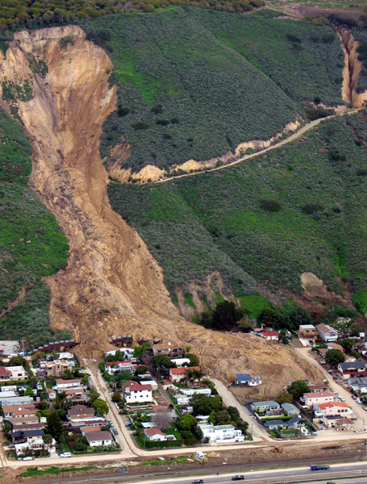
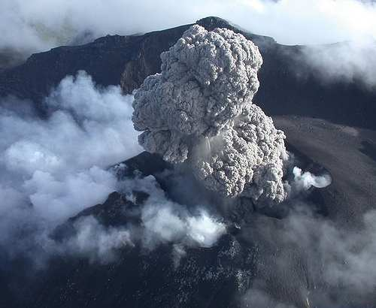
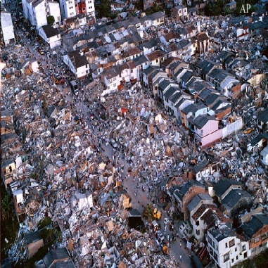
Us
TEYDE, Territorio y Desarrollo, SAC is a Peruvian company of consulting and engineering, with branch in Spain, in the Canary Islands.
We provide services in the field of the sustainability of natural resources, as well as in other areas of engineering and earth sciences, applying a comprehensive project concept, design, drafting, administrative procedures and execution - and permanently betting on the innovation.

Slide 3
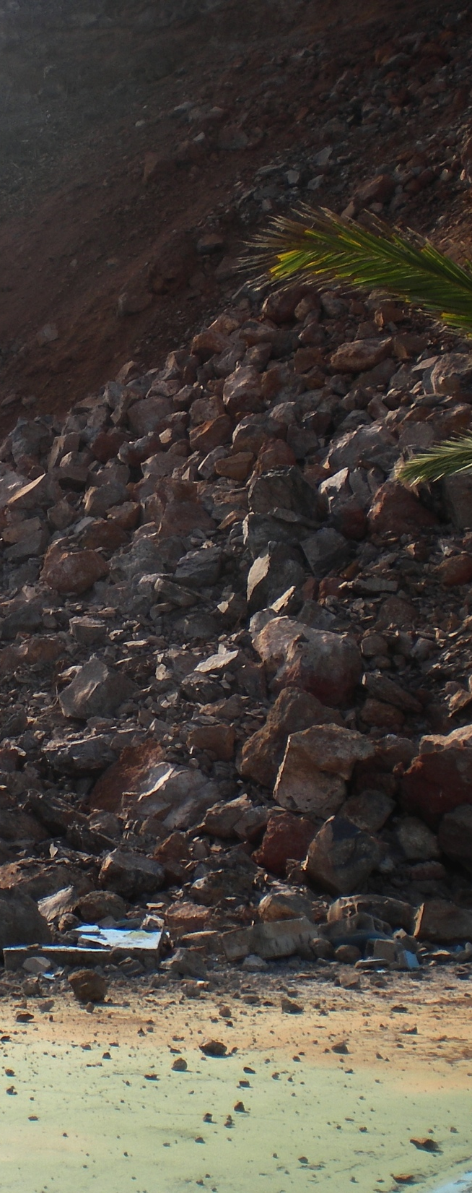
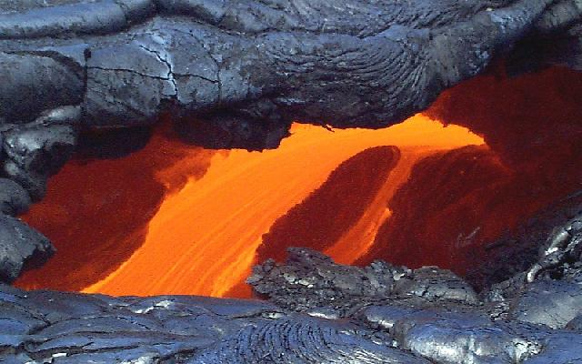
Geological
hazards
The losses caused by the natural disasters of the increase, with serious consequences for the survival, dignity and livelihoods of people.
Natural risk studies are aimed at reducing risk from unacceptable values to acceptable values. TEYDE's work in this field focuses on the study and characterization of risks, the generation of support tools, and the implementation of prevention and mitigation measures.
We designed and implemented the following mitigation measures:
Preventive non-structural, such as education and social awareness, management plans and civil protection and emergencies, as well as warning and alert systems.
Preventive or corrective of structural type, like barriers, elements of reinforcement, canalizations, excavations, etc.
Avenues <
Slope movement <
Seismic<
Volcanic<

Slide 4
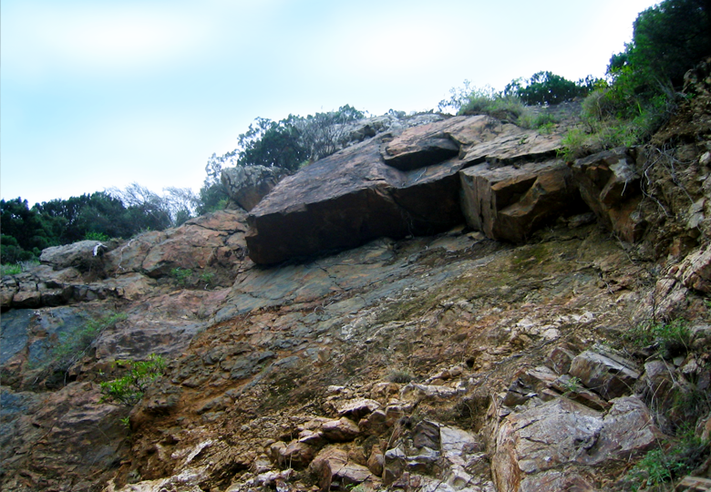
SERVICES IN
GEOLOGICAL RISK DETACHMENTS

Slide 5
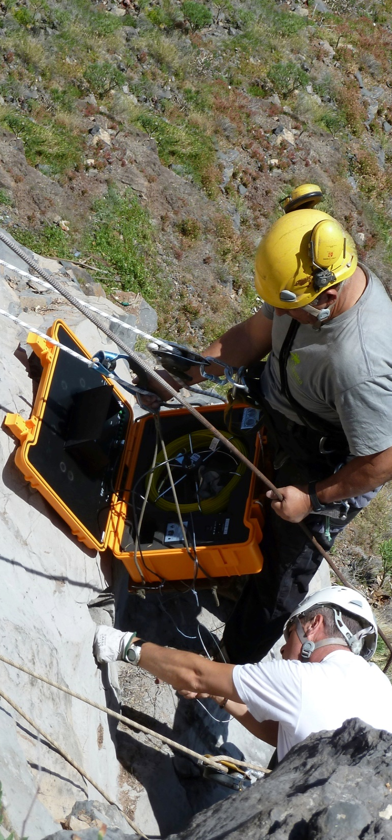
SERVICES
IN RISK
Geological
Detachments
We provide the following services:
Risk studies in relation to detachments.
Reports of landslides and movements.
Slope stabilization projects and protection against landslides.
Construction management and specialized advice.
The company TEYDE accumulates a wide experience in this type of risks, with an offer that stands out in the following aspects:
Methodology of work.
Scale of study. From regional to construction projects.
Technical means. Topographical, GIS applications and analysis of detachments.
Human resources. Engineers and geologists with extensive experience in this field.

Slide 6
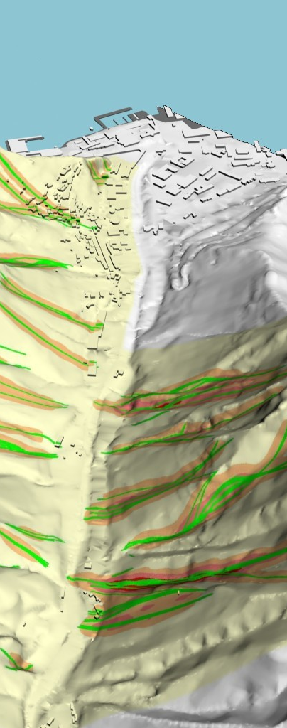

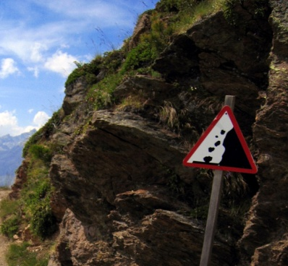
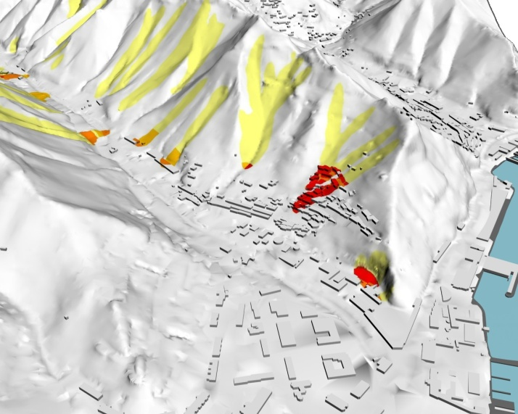
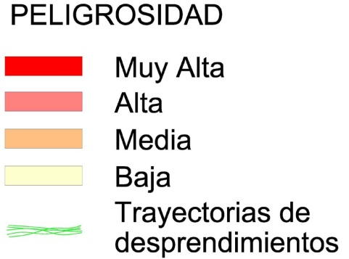
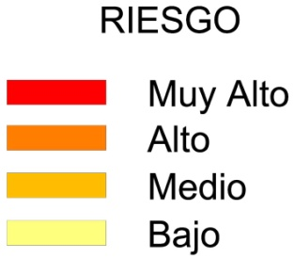
RISK STUDIES
Against
landslides
Focused mainly on planning risk studies by landslides are directed to areas of variable range that present a dispersed problem and of different magnitude.
This way of working allows to achieve, among others, the following objectives:
Prioritization of actions: The most sensitive areas are identified for the development of action projects.
Increased security: The identification of priority areas allows directing the actions to the most conflicting points.
Reduction of global costs through studies and projects.
Security optimization vs costs.

Slide 7
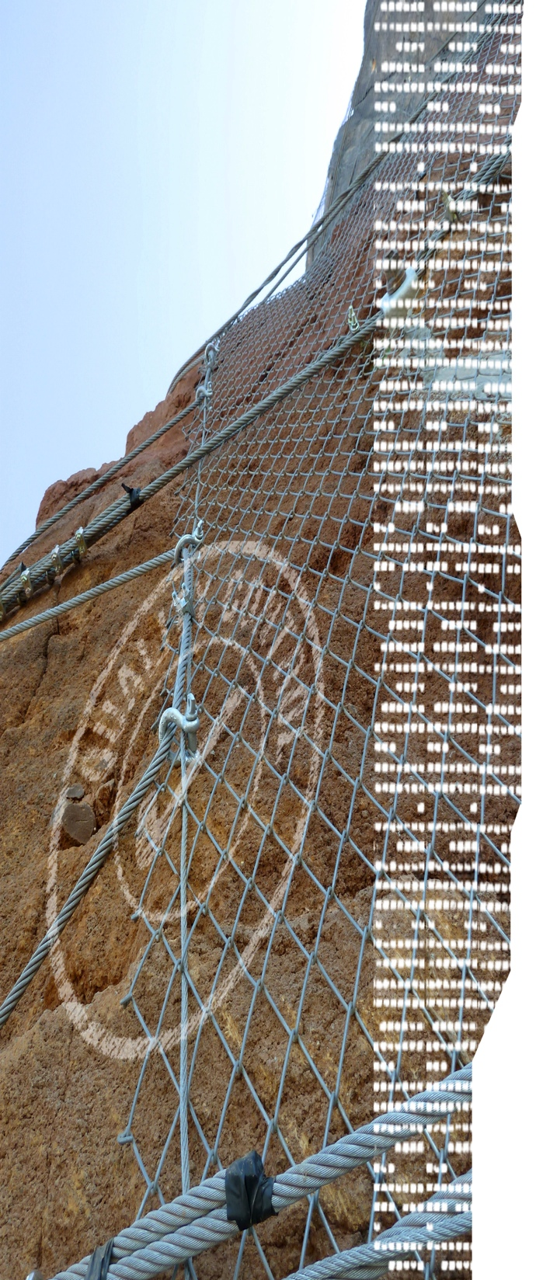
STUDIES AND PROJECTS
The purpose of these works is to define and evaluate the actions necessary to minimize the risks caused by possible landslides. For this, several solutions or alternatives are provided to be able to select the one that is best adapted in time, budget and maintenance.
The quality of our work is supported by the following pillars:
Experience.
Accuracy of the data. High precision surveying equipment.
Balance security / cost. Studies of different types of solutions.
Analysis of detail. Detailed sectorization of problems.

Slide 8
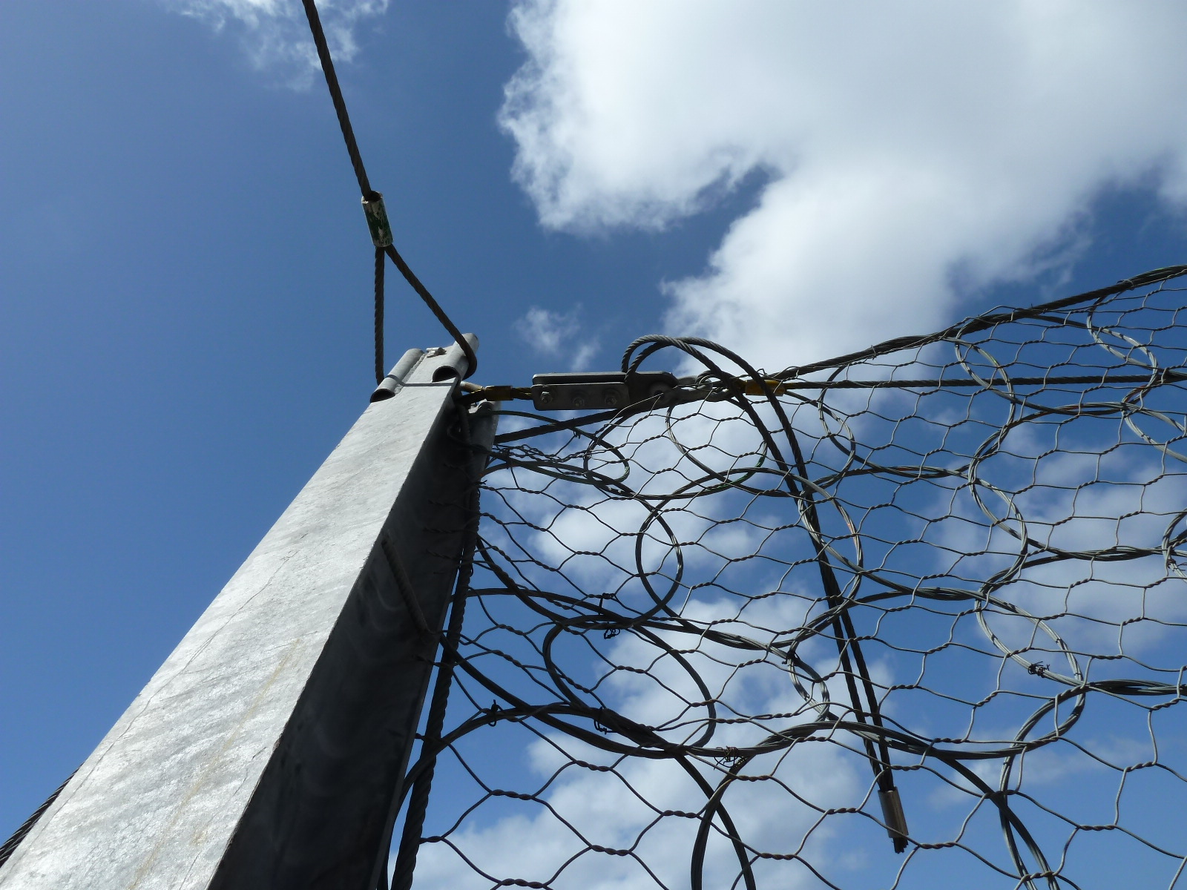
06
THE PROTECTION

Slide 9
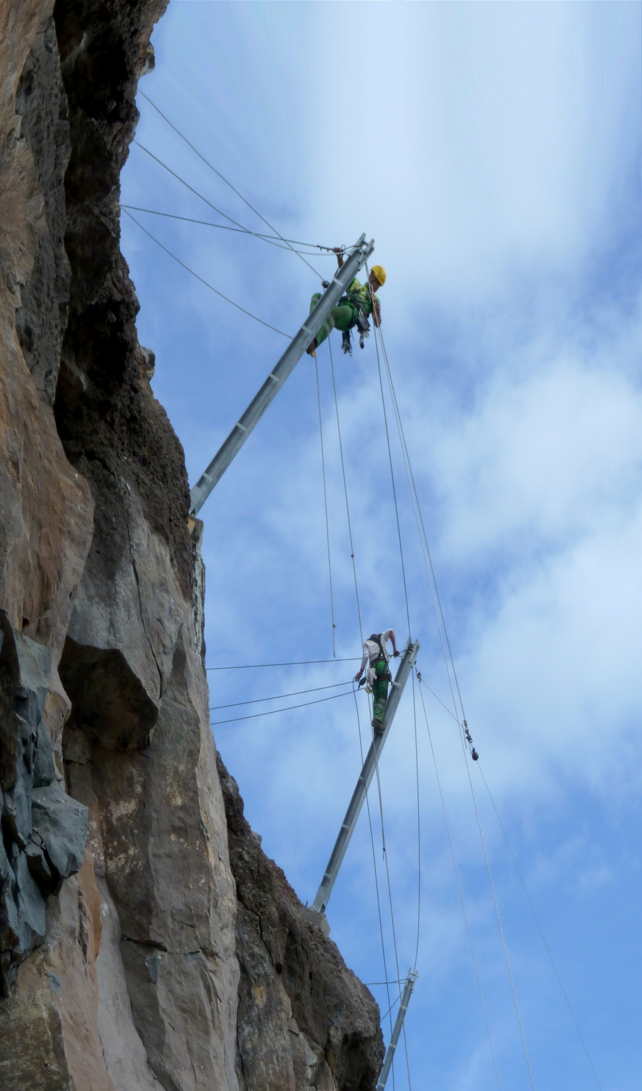
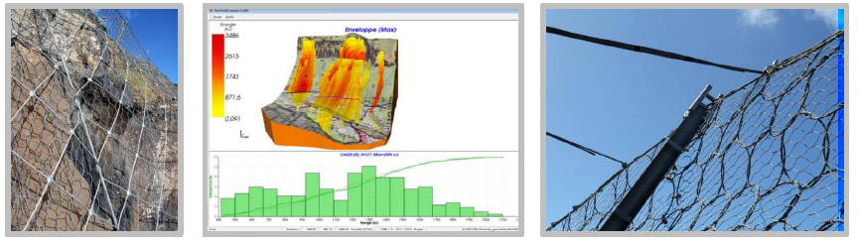
PROTECTION
The correct calculation and the adequate dimensioning of the protections allows to optimize the public security
Study of trajectories of detachments using specific software.
Elaboration of energy profiles of the most representative trajectories.
Proposed solutions. Commitment between security and budget.
Behavior of solutions in energy profile.

Slide 10
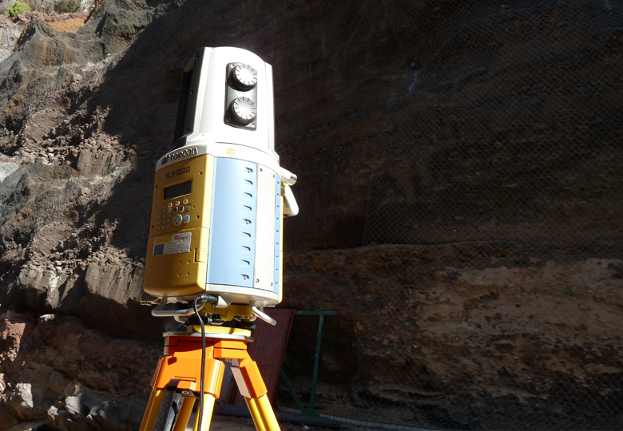
07
PRECISION

Slide 11
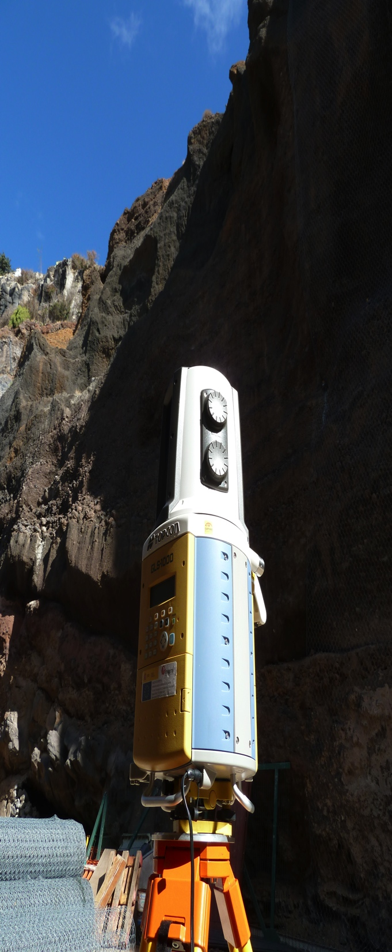
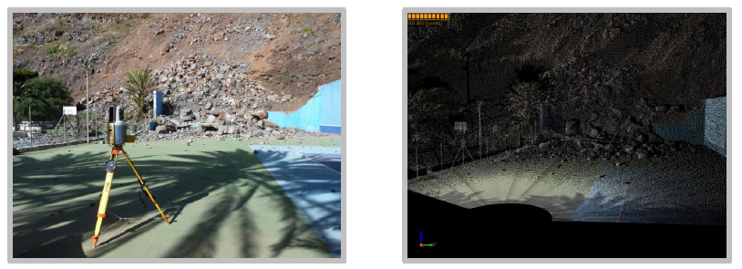
PRECISION
The precision in the calculations guarantees a significant reduction of costs in the performances
Topographic survey detail: It is performed in areas where it is necessary to have more detailed information. Accurately determining the size of unstable blocks and other terrain details. This topographic survey of detail is made by a Topographic Laser Scanner of high precision (Laser Scanner GLS-1000 of Topcon).
Reduction of costs: It is estimated that a minimum saving of 50% can be achieved on the total budget of a performance.

Slide 12
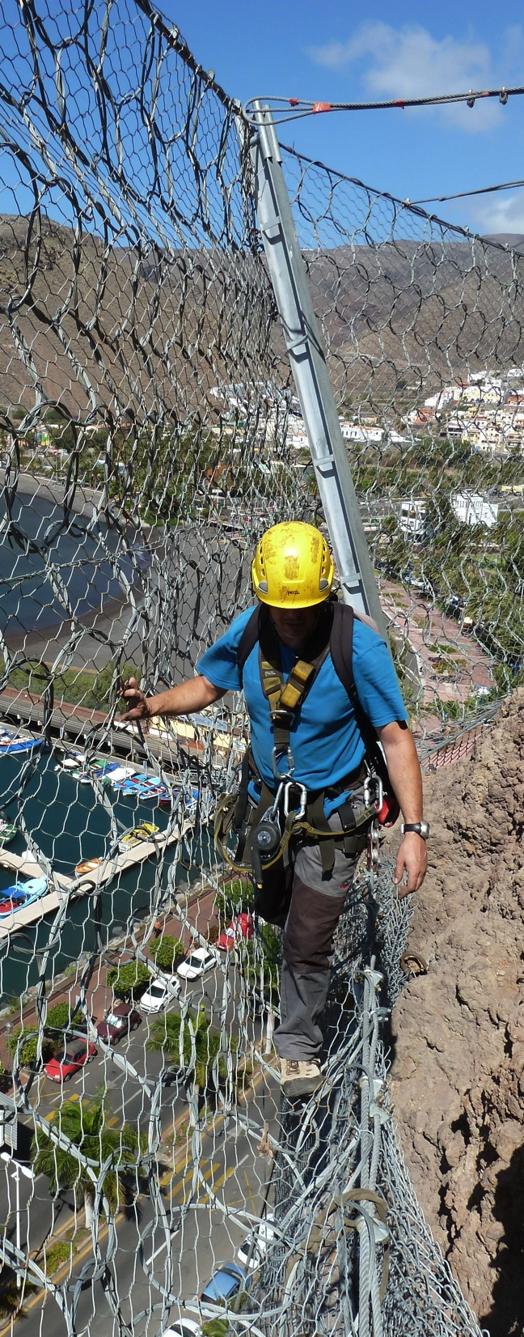
Construction
Management
A good project or a product of very good quality is not a guarantee of safety if the installation is not adequate. TEYDE offers Construction Management services by monitoring the necessary actions and ensuring the correct execution of the protections, from the reception of materials to the final putting into service of the protection elements.
Our technicians have training certificates issued by ANETVA (National Association of Companies of Vertical Jobs), with which the monitoring of work is done on the ground.

Slide 13
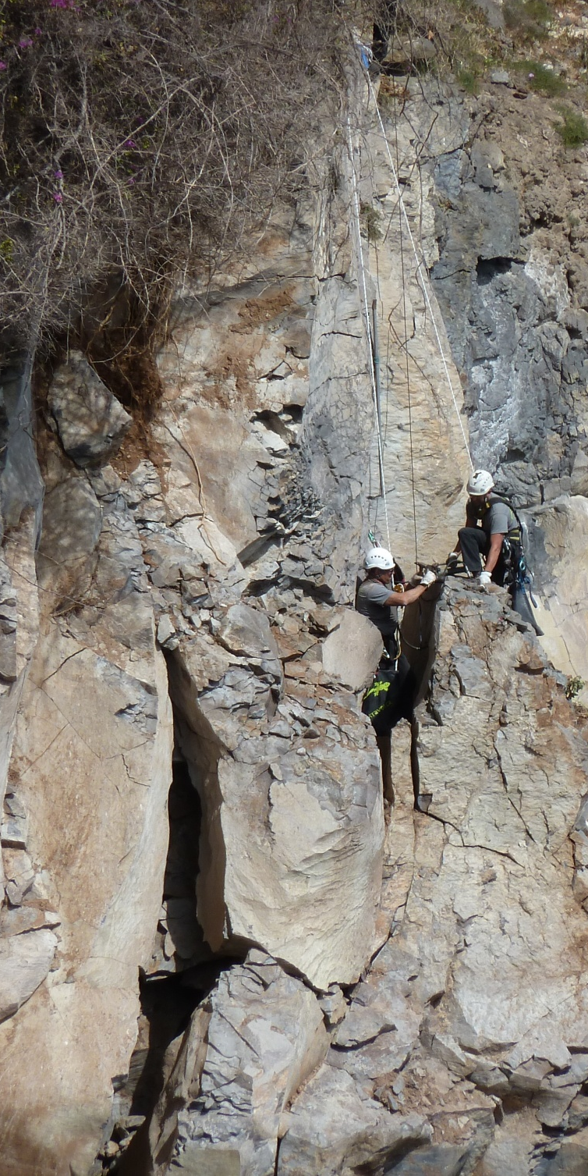
SPECIALIZED ADVICE
The proper monitoring and control of the execution of the works provides the greatest guarantee of quality
In many cases the lack of specific knowledge makes that the technical advice to who receives the product comes only from the company that installs it. It is usually chosen the cheapest system without the customer know for sure the safety guarantees offered.
TEYDE is an independent company that is not linked to any product manufacturer or installation company. Our independence guarantees that we will always recommend to our customers the best solution in an equal safety condition.

Slide 14

We are in:
+ España
Fernández Navarro 50, 3ºA.
37003. Santa Cruz de Tenerife.
España
+ Colombia
CR 10 # 73 20 Oficina 202.
Bogotá. Colombia.
+ Perú
Urb.Las Fresas , Mz V , Lt 12.
Santiago de Surco, Lima 33.
Lima, Perú.
+ Cel: +34 619 745 190
+ Cel: +51 962 675 092
+ Cel.:+51 948 893 145
+ ghduran@me.com
+ www.teyde.pe

