Slide 1
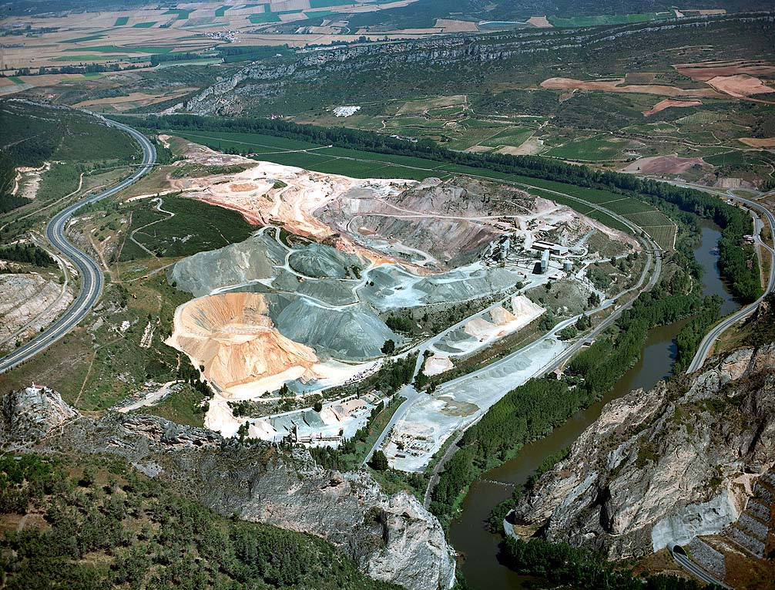
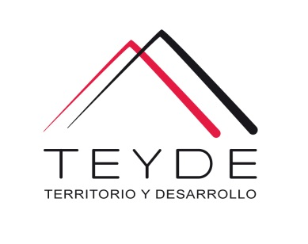
Mining services
MINING ORDINATION, REHABILITATION AND MINING CLOSURE

Slide 2


Us
TEYDE, Territorio y Desarrollo, SAC, is a Peruvian independent consulting and engineering company, with branch in Spain that has business experience since 1999.
We provide services in the field of territorial sustainability, as well as in other areas of engineering and earth sciences, applying a concept of integral and dynamic process in territorial intelligence, and permanently betting on innovation.

Slide 3
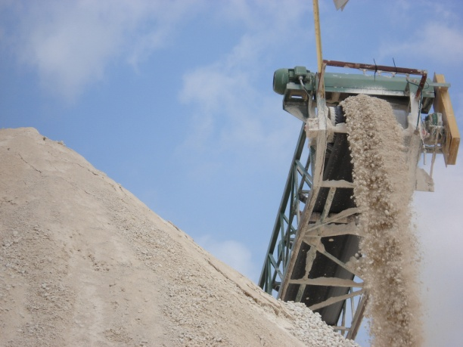
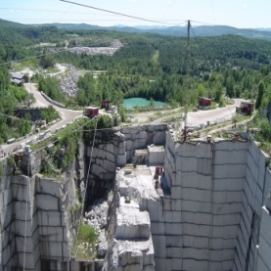
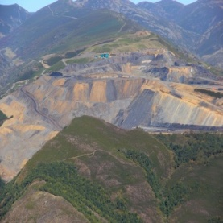
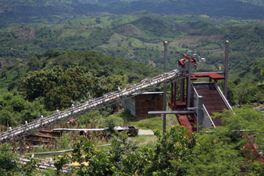
Mining Services
TEYDE is an expert in the whole process of territorial management that involves mining activity, from previous territorial planning, environmental mining planning, design of exploitation and restoration models, through the exploitation and restoration projects themselves, and Environmental impact studies.
Thanks to this, any link in this chain is better understood and developed, using the best technology at all times.
TEYDE is a reference company in Spain in the field of mining resource management, highlighting the use of GIS, ground motion modeling software, and the use of laser scanners for topographic surveys of high density and complexity.
  Mining Management
  Models of exploitation and restoration,
  And regulatory guidelines
  Rehabilitation and closure of mines
  Geological - Geotechnical Studies and Reservoir Modeling
  Operation and restoration projects
  Environmental impact studies

Slide 4
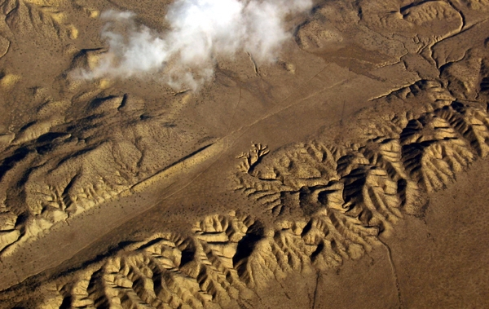
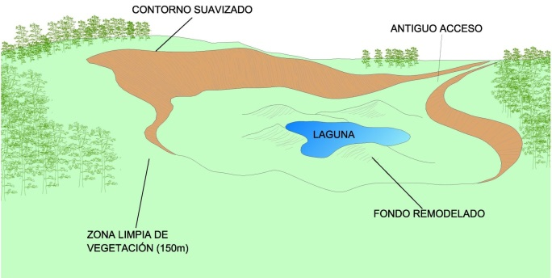
Mining services
In the field of mining we offer a global service, from the first steps of reservoir research to the Closing of the Mine or Rehabilitation of the farm, advising companies already consolidated in the sector and new companies.
We design and plan new farms drafting the corresponding projects and carry out a complete follow up of the procedures in the administration until its correct authorization.
We offer advice for the design and design of new treatment plants and supervise plants in operation to ensure continuous optimization of yields.
The quality of our work is based on the following pillars :
Experience.
Accuracy of the data. High precision surveying equipment.
Balance security / cost. Real study of different types of alternatives.

Slide 5
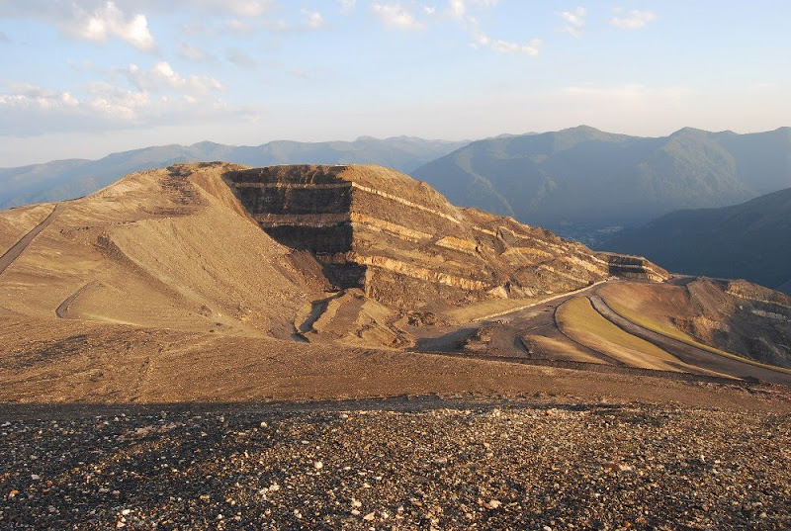
  Mining
  Management

Slide 6
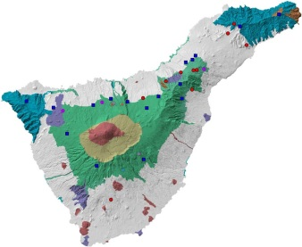
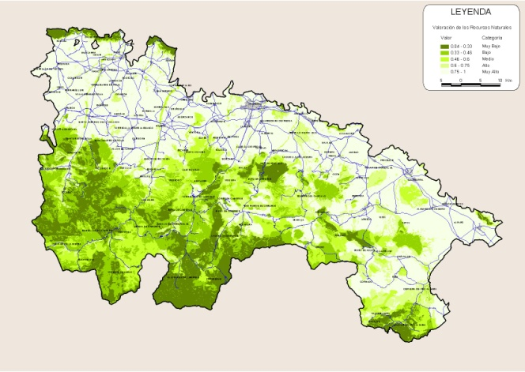
Mining Management
TEYDE is a reference company in Spain in this area. In the field of mining management plans we offer a complete service according to the needs of our clients in terms of their typology:
  Territorial plans for the management of mining and extractive activities.
  Special plans of environmental management and equipment.
  Partial plans.
In order to achieve complete coverage of our clients' needs we offer various solutions that are mainly :
  Maps of mining - environmental compatibility.
  Models of restoration and exploitation.
  Environmental impact studies.
  Mining management guidelines.
  Environmental sustainability report.

Slide 7
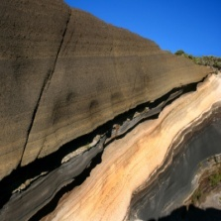
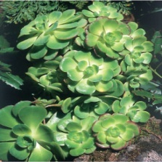
Mining management
Objective
IDENTIFY THOSE AREAS OF THE TERRITORY WITH A HIGHER FITNESS FOR THE GROWTH OF THE MINING SECTOR, FROM A BALANCE BETWEEN THE PRESENCE OF GEOLOGICAL RESOURCES AND THE ENVIRONMENTAL FRAGILITY TO THE MINING ACTIVITY.
MINING MANAGEMENT STUDY
ENVIRONMENTAL OBJECTIVES:
ESTABLISHMENT OF THE OPERATING MODELS, SO THAT THE BENEFIT OF THE RESOURCES WILL BE IN THE MOST RATIONAL AND SECURE, WITH THE LESS THAN MEDIUM AFFECTION
DETERMINATION OF CRITERIA FOR THE RESTORATION OF LAND AFFECTED BY MINING ACTIVITY
DEVELOPMENT OF A MINING - ENVIRONMENTAL MANAGEMENT MAP BASED ON THE INTEGRATION OF MINING ACTIVITIES IN THE TERRITORIAL ORDINATION PLANS

Slide 8

Maps of mining-environmental management
WHERE SHOULD THE MINING ACTIVITY BE LOCATED?
CAPACIDAD DE ACOGIDA
Aptitud o potencialidad del territorio
Vulnerabilidad o fragilidad del medio
QUALITY AND PROFITABILITY OF THE RESOURCE
ENVIRONMENTAL FRAGILITY
AND LANDSCAPE
PREVIOUS ANALYSIS
TERRITORIAL DIAGNOSIS
ZONING THE TERRITORY
ZONING THE TERRITORY

Slide 9
Maps of mining-environmental management
General structure of the analysis. Information Blocks
SOCIOECONOMIC SYSTEM
NATURAL RESOURCES
PHYSICAL ENVIRONMENT
MINING INTEGRATION
PRE-EXISTING IMPACTS DERIVED FROM THE EXTRACTIVE ACTIVITY
CAPACITY OF THE TERRITORY TO ACCOMMODATE THE MINING
GEOLOGICAL RESOURCES WITH MINING POTENTIAL
RESTRICTIONS OF NORMAL TERRITORIAL TYPE TO MINING
POTENTIAL MINING AREAS
MAP OF MINING AND ENVIRONMENTAL MANAGEMENT

Slide 10
Models
The plans of mining territorial planning incorporate models of exploitation and restoration. The latter give a framework of action to different typologies of exploitation, which are then specified in the normative documents.
MODELS OF EXPLOITATION AND RESTORATION
Establishment of the most relevant criteria regarding the design, planning and execution of farms and the corresponding restorations.
MODELS OF EXPLOITATION
Execution of extractive work
Access road to farms
Drainage conditions
Pickling and preservation of edaphic material
Dump conditions
Territorial insertion conditions
RESTORATION MODELS
Restoration levels
Morphological restoration
Restoration of hydrological conditions
Eradication of infrastructures and installations
Fillings
Refurbishment of the vegetation cover
Usability Compatibility
BASIS FOR THE DEVELOPMENT OF THE MINING ORDINATION GUIDELINES

Slide 11
Normative guidelines
In addition, TEYDE has participated in the elaboration of territorial sectoral mining legislation, and management guidelines, at regional and local level.
The Mining Management Guidelines are the ultimate expression of the objectives and criteria followed in the development of the different management documents.
MAP OF MINING - ENVIRONMENTAL COMPATIBILITY
MODELS OF EXPLOITATION AND RESTORATION
MODEL OF TERRITORIAL ZONING CHOSEN
ESTABLISHES A SERIES OF OPERATING MODELS AND CRITERIA WITH A HIGHER OR LOWER IMPACT ON THE ENVIRONMENT
ESTABLISHES A SERIES OF CORRECTION MEASURES OR MITIGATION OF IMPACTS
ESTABLISH A DIVISION OF THE TERRITORY IN ZONES ACCORDING TO THEIR LARGEST OR LESS CAPACITY OF RECEPTION FOR THE MINING ACTIVITY
ORDINATION GUIDELINE BASED ON FITNESS MATRICES
In areas with greater capacity of reception will be allowed any model of exploitation and the measures of correction of impacts will not be too demanding.
In areas with less capacity of reception only those models of exploitation that are more respectful with the environment will be allowed and the measures of correction of impacts will be very demanding.

Slide 12
Normative guidelines
Matrix of aptitude of implantation of typologies
COMPATIBILITY ACCORDING TO RESTRICTIONS OF USE |  | COMPATIBLE |  |  | COMPATIBLE WITH ENVIRONMENTAL RESTRICTIONS
ZONES ACCORDING TO FITNESS |  | ZA I | ZA II | ZA III | ZA I | ZA II | ZA III
SITE LOCATION AND TYPOLOGY OF EXCAVATION
FARMS IN HORIZONTAL LAND | Excavation frustoconical or short | * | * | * | * | *
 | Excavation with lateral advance | * | * | * | * | * | *
FARMS IN HILLSIDE | Front advancement and rising height front | *
 | Downward Banking | * | *
 | Falling bank with protective mass | * | * | * | *
LOCATION AND TYPOLOGY OF ESCAPERS
DEBRIS PLACE | Temporal | * | * | * | * | * | *
 | Permanent | *
 | Outside | * | * | * | *
 | Inside | * | * | * | * | * | *
LOCATION OF TREATMENT FACILITIES AND PLANTS
PLANTS | Outside | * | *
 | Intside | * | * | * | * | * | *

Slide 13
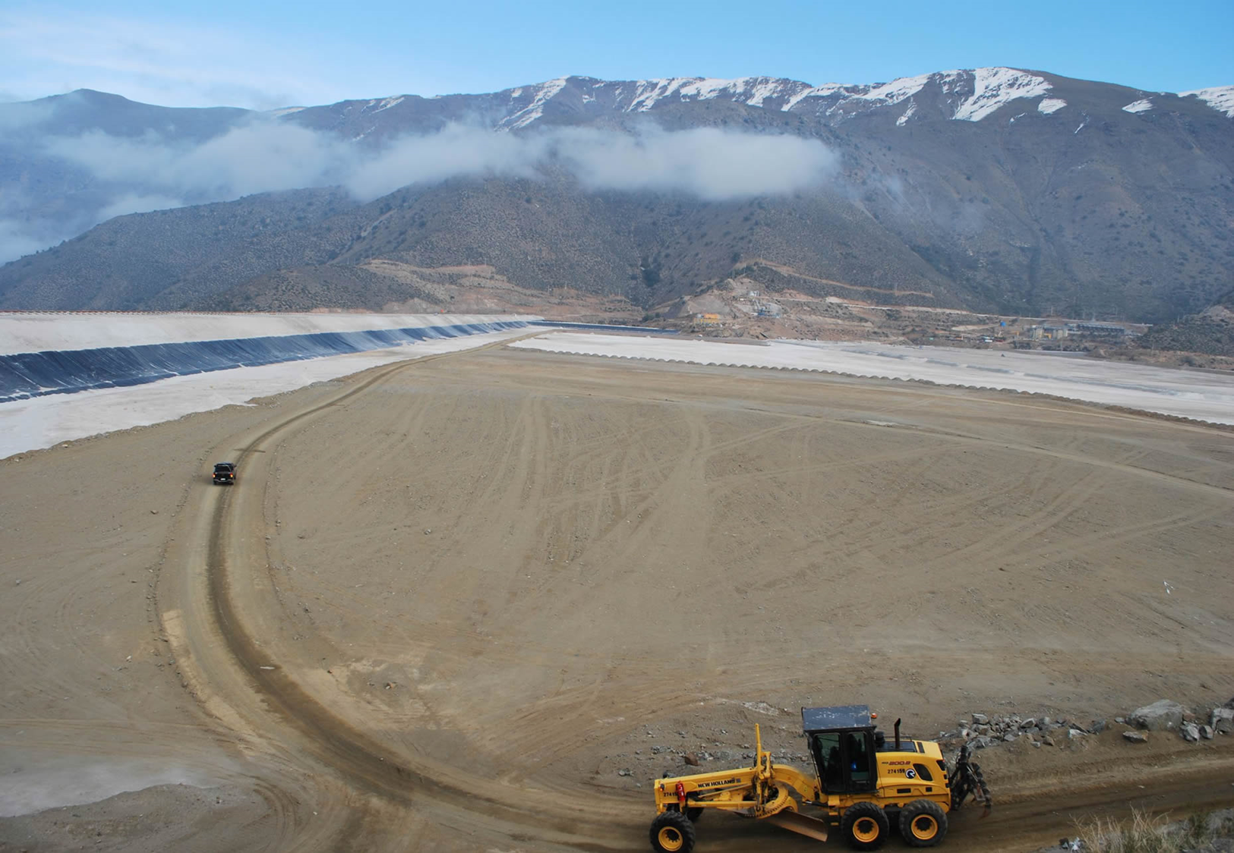
06
  Study of
  NATURAL HAZARDS

Slide 14
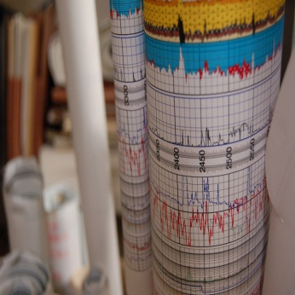
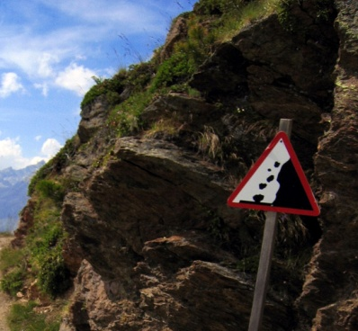
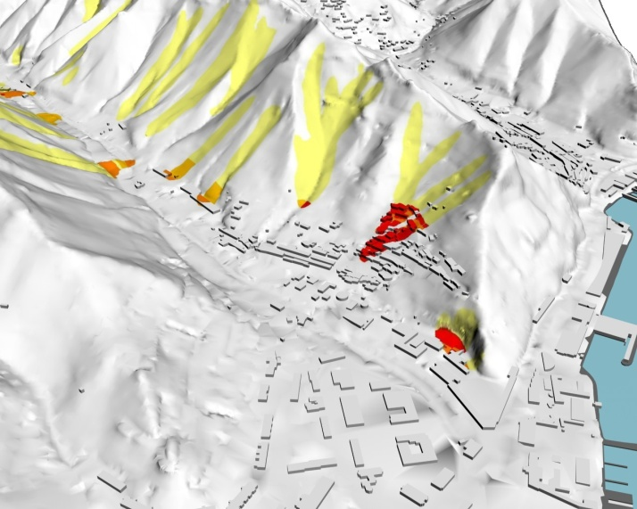

Study of NATURAL HAZARDS
The study and mitigation of natural and anthropic hazards is one of the fields where our company accumulates a greater experience. Our activity includes all the necessary steps to achieve the solution more in line with the magnitude of the problem because we work from a global perspective of risk management designing and developing:
  Previous field studies.
  Prevention (analysis and simulation, design, dimensioning and design of measures), prediction (anticipation of the phenomenon) and immediate intervention (risk management once triggered).
  The education of the behavior to the risk through the awareness and education of the population).
  The direction of the execution works.

Slide 15
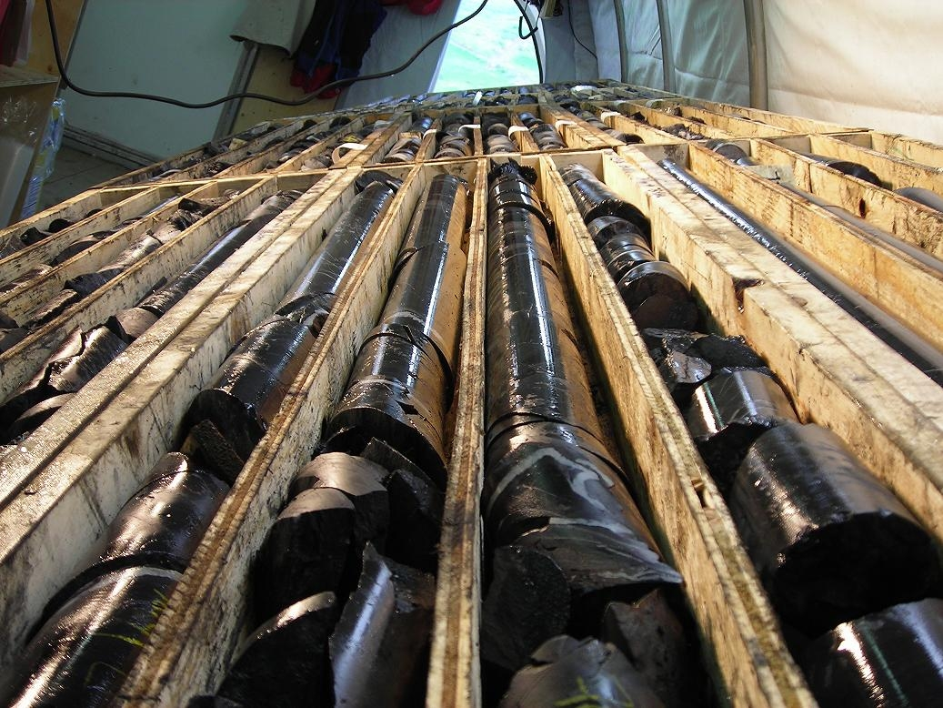
  Studies
  GEOLOGICAL-GEOTECHNICS

Slide 16
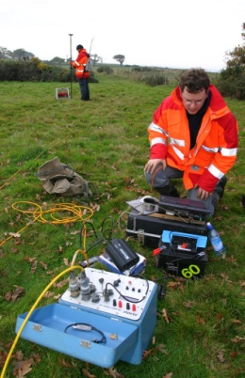
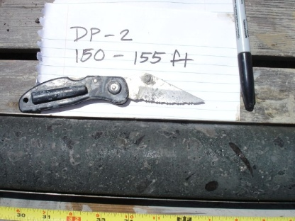
Studies Geological-geotechnics
From our experience we know the importance of the previous valuation of the land in view of a future exploitation, that is why in TEYDE we work in the investigation phases of deposits in a specific and coordinated way with a future exploitation of the found resources aiding us of the last technologies To obtain the most objective and precise view of the volume of materials. Our previous work includes in addition to exploration, exploration and scientific, chemical, geological and metallurgical research.
At TEYDE we have a variety of prospecting techniques using the most suitable for the purposes pursued by our clients:
Vertical electrical probes.
Seismic refraction.
Georadar
Mechanical surveys or tastings among others.
We always seek the best relationship between the quality of work, the characterization of the materials and the budget of the campaign, providing the best balance between quality and price.

Slide 17
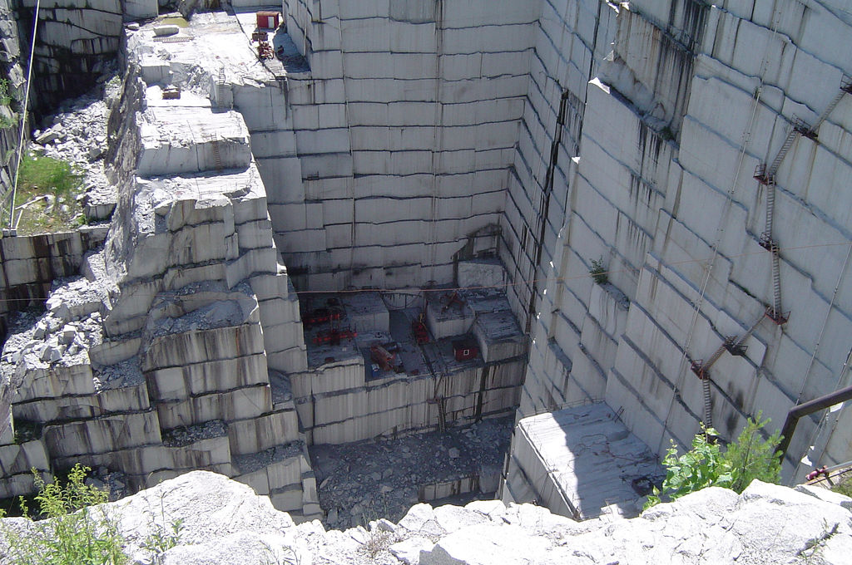
  Projects of
  REHABILITATION AND CLOSURE OF MINES

Slide 18
Mine closure
TEYDE is an expert in the entire territorial management process that involves mining activity, from previous territorial planning, to mine closure, through environmental mining planning, design of exploitation and restoration models, and projects.
Thanks to this, any link in this chain is better understood and developed, using the best technology at all times.
TEYDE participation
Environmental Management Tools
4. Execution.
Monitoring and control
1. Enviromental Minerals Management
1. Sensitization
4. Citizen participation
3. Closing plan
2. Restoration models and guidelines
2. Transparency
3. Interactive Communication and Dissemination

Slide 19
Mine closure
Integration of mine closure plans within the stages of mining process
STAGE OF THE PLAN CLOSURE
Closing plan
PLAN UPDATE,
COST ESTIMATION
PLAN UPDATE
(Environmental permits, mining inspections, operational changes)
IMPLEMENTATION AND CLOSURE DOCUMENTATION
INITIAL CLOSURE
PLAN
GUARANTEE THE ADEQUACY AND THE SUCCESS OF THE MEASURES ADOPTED
OPERATING PERMITS
END OF PLAN AND SHIPPING TO AUTHORITIES
PROCEDURES AND PERMITS
APPLICATION FOR A CONCESSION
- Plan of operation of the
Concession
- Basic studies
- Studies and Reports
Environmental
STAGES
OPERATIONAL
EXPLORATION
VIABILITY
STUDIES
BUILDING
AND ASSEMBLY
EXPLOITATION
AND BENEFIT
STOP AND DISMANTLING
MONITORING AFTER ABANDONMENT

Slide 20
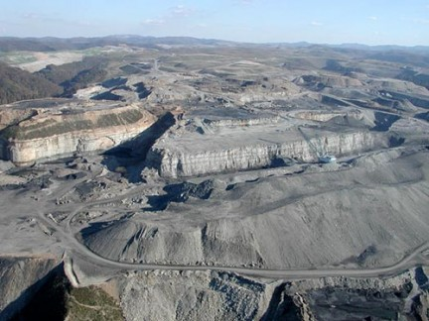
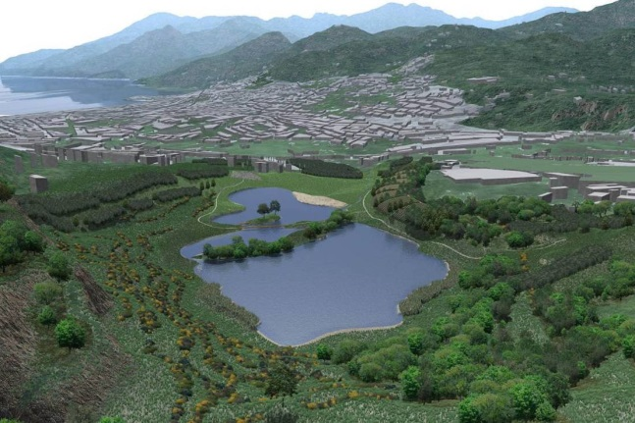
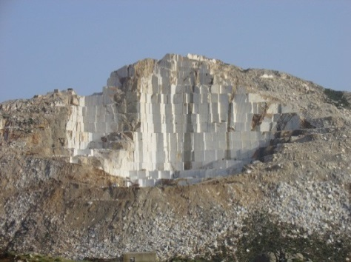
Mine closure. Working methods
Our methodology, directed to the design and monitoring of the Mine closure, through the application of novel design techniques, and the topographic control of the farms guarantees a better planning of the excavation and restoration work. TEYDE uses powerful computer tools that allow to work in three dimensions the stratigraphy of the terrain, automating the differentiated cubiculation by lithology before any change of design in the parameters of excavation (gravel, profiles, ...) with the added environmental value of being able to visualize three-dimensional The solution chosen by infographics.
PRECISION CONTROL PERFORMANCE

Slide 21
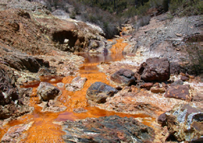

Mine closure. Environmental assessment and monitoring
The purpose of our Environmental Impact Assessment and Assessment work is to define and evaluate the actions necessary to minimize the environmental and social impacts derived from the mining activity during the entire useful life of the operation, from the initial exploration of the site Until the rehabilitation and closure of the same. For this, several solutions or alternatives are provided to be able to select the one that is best adapted in time, budget and maintenance. These alternatives are characterized by:
Analysis of detail. Detailed sectorization of problems.
Extensive knowledge of the regulatory framework governing EIAs.
Wide multidisciplinary human team that allows us to act effectively on all physical, biological, socioeconomic and human environmental disciplines.
At TEYDE we are aware of the social impacts that large-scale mining projects can entail, we encourage and seek public involvement through participatory decision-making in projects that involve environmental solutions.

Slide 22


Exploration
Mine closure.
PLANNING
CONCEPTUAL
OF THE CLOSURE
Planification
PLANNING
CONCEPTUAL
OF THE CLOSURE
Pre-feasibility study -
Challenges related to the physical closure of a mine have been replaced by challenges associated with the nature and acceptance of closure results and the ability to 'work' processes to achieve acceptable results by integrating closure considerations with Day-to-day business practices. The physical activities necessary to reach the closure are relatively simple. The biggest challenges are posed by the alignment, definition, implementation, review and adjustments of the closure plan to provide a sustainable exit strategy. However, by carefully applying thought and commitment around this process, obtaining mutually beneficial closure outcomes could become a less disproportionate task for mine operations.
Pre-feasibility study -
Constructions-
Operations -
Life cycle of the mine
Ciclo de vida útil de la mina
Contribution of stakeholders
GROWING
DETAILS
Aporte de los grupos de interés
PLANNING
DETAILED
OF THE CLOSURE
PLANNING
DETAILED
OF THE CLOSURE
Dismantling–
Transition to
The closure
Closure –
Transición hacia
el cierre
Post Closure–
Abandonment of the concession –

Slide 23
Mine closure. Planification
DETAILED CLOSURE PLAN
INDICATORS FOR VERIFICATION OF GENERAL OBJECTIVES AND INTERMEDIARIES
THEY'RE
ACHIEVING
EXPECTED
OBJECTIVES
EXPECTED INTERIM OBJECTIVES
HOW THESE INDICATORS WILL
BE OBTAINED
ACTION PLANS
WHO IS RESPONSIBLE FOR THIS MEASURE TO BE CARRIED OUT
THE RESOURCES NEEDED TO CARRY OUT THE MEASURE
WHAT SHOULD BE DONE
WHEN SHOULD
THE COST OF MEASUREMENT

Slide 24
Mine closure. Management tools
Within the entire implementation process of mine closures, it is vital to have management and monitoring tools. They are a strategic support in many of the stages and aspects related to the closure of mines.
CLOSURE PLAN
CONTROL OF THE TECHNICAL ASPECTS OF THE CLOSURE OF MINES
STAGES OF
CLOSURE PLAN
SOILS
WATER
WASTE
GEOLOGICAL AND ENVIRONMENTAL RISKS
LANDSCAPE
PROJECT MANAGEMENT
PARTICIPATION
INITIAL CLOSURE PLAN
PLAN UPDATE
IMPLEMENTATION OF THE PLAN
MONITORING AFTER ABANDONMENT

Slide 25
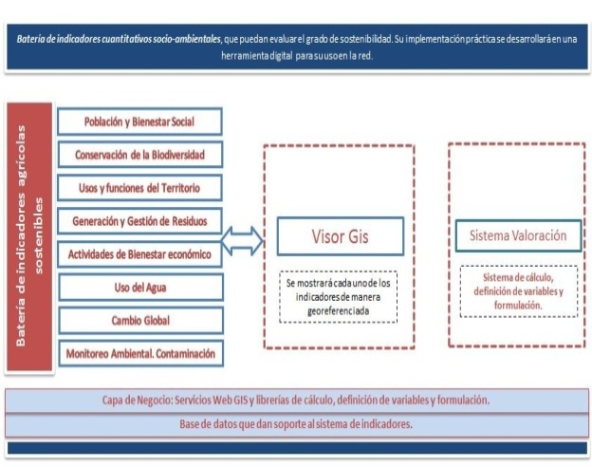
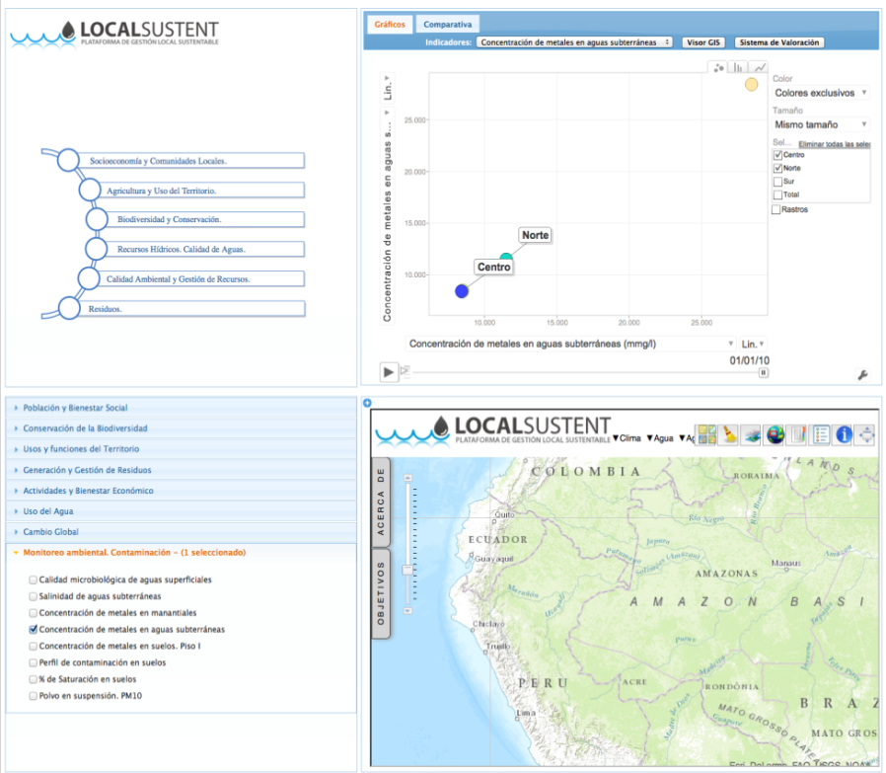
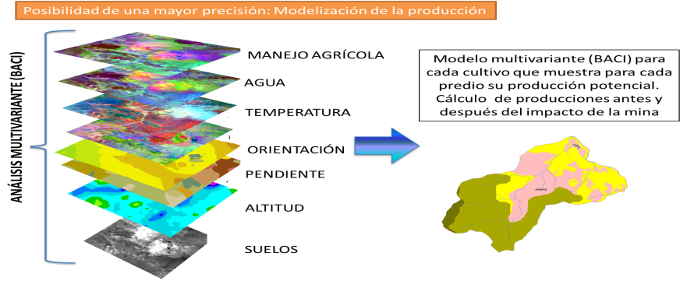
Mine closure. Management tools
Territorial management tools are an indispensable aid in the detailed planning of closures. Design - monitoring - verification of compliance with general and intermediate objectives.

Slide 26
Equipment.
The precision in the calculations guarantees a significant reduction of costs in the performances.
TEYDE has, among others, the following elements:
SOFTWARE:
Advanced Arcgis Server
Ispol - Istmos for design of linear work, mining design and great earth movements.
Autodesk
3D Studio
HARDWARE:
High-Precision Laser Scanner (Topcon Laser Scanner GLS-1000).
Digital sounding system for soundings.
In addition, we have a multidisciplinary and expert human team in each of the sectors in which we work, which has allowed us to develop methodologies for training and professional training in mining and environment for all levels of the workforce of our clients. An example of our successes in this field is the development of online training platforms as well as the preparation of manuals and technical guides for mining operations.

Slide 27

We are in:
+ España
Fernández Navarro 50, 3ºA.
37003. Santa Cruz de Tenerife.
España
+ Colombia
CR 10 # 73 20 Oficina 202.
Bogotá. Colombia.
+ Perú
Urb.Las Fresas , Mz V , Lt 12
Santiago de Surco, Lima 33.
Lima, Perú.
+ Cel: +34 619 745 190
+ Cel: +51 948 893 145
+ Cel.:+51 962 675 092
+ ghduran@me.com
+ www.teyde.pe

